Slide 1
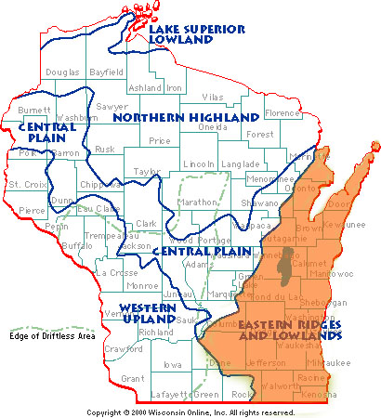
Eastern Ridges and Lowlands

Slide 2
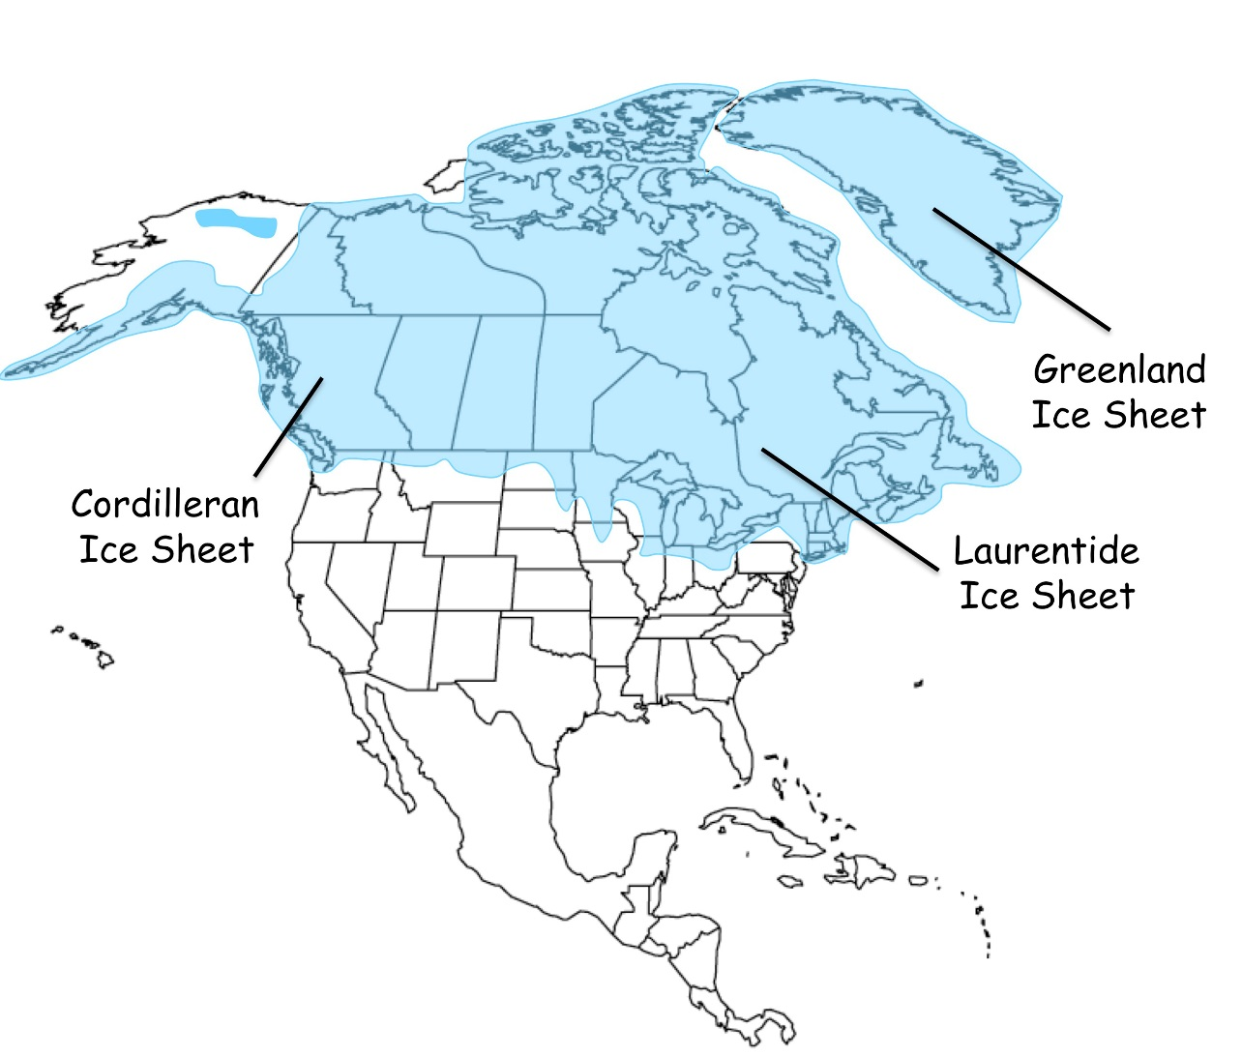
Laurentide Ice Sheet

Slide 3
southeast
The Eastern Ridges and Low Lands are located in the _____________________ part of the state
Lake Michigan
And its eastern board is created by __________________.
What lobes of the Laurentide Ice Sheet covered the Eastern Ridges and Low Lands?
Green Bay Lobe and Lake Michigan
N

Slide 4
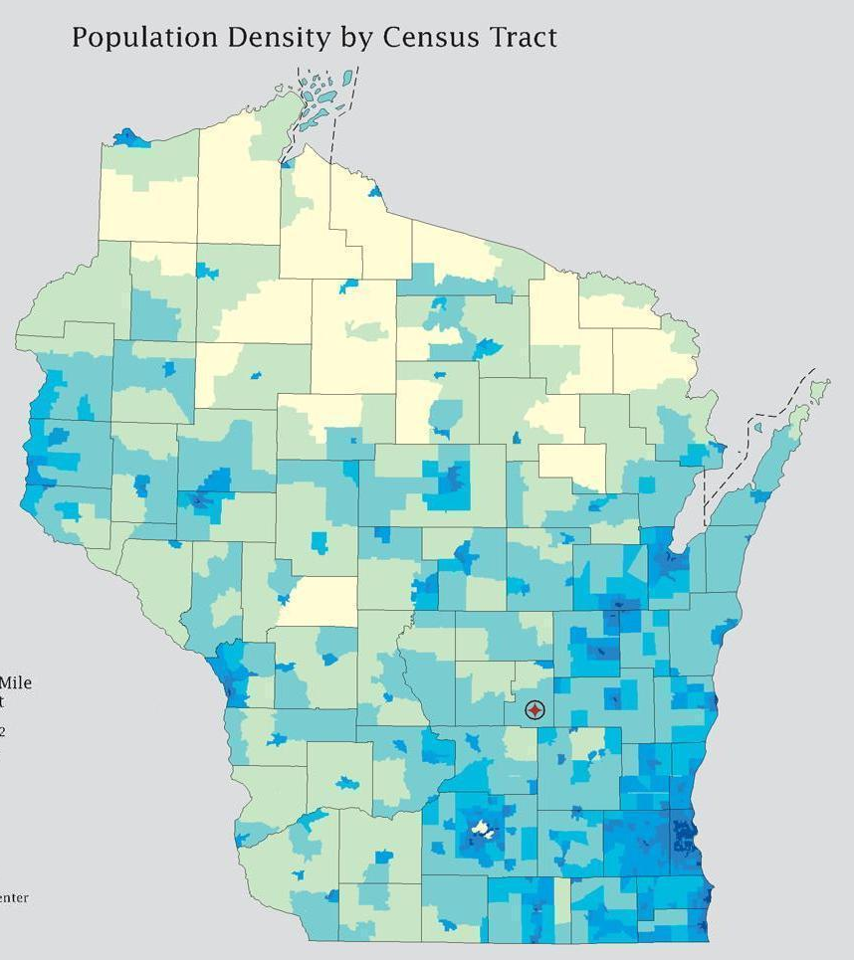
The largest population of Wisconsin occurs in which province?
Eastern Ridges and Lowlands
On/Off
WHY ????
Level topography
Topography is the
arrangement of physical features
The dominant thing in eastern Wisconsin is the
plain
Escarpment
Fertile soil
Favorable climate

Slide 5
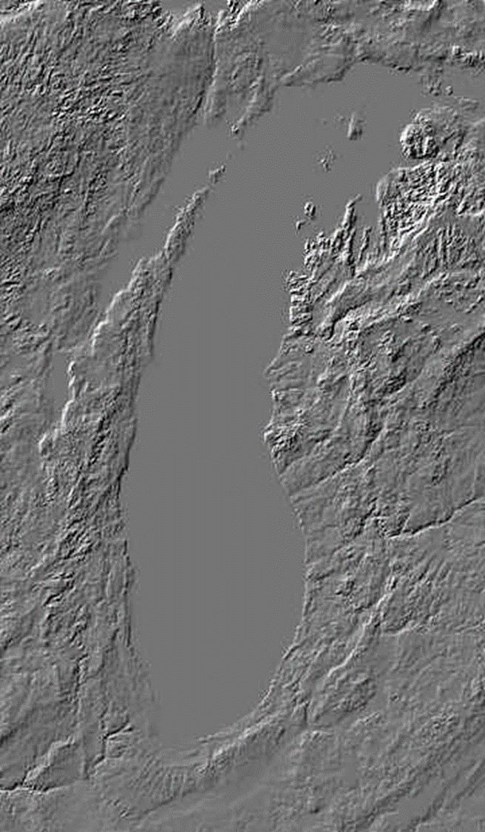
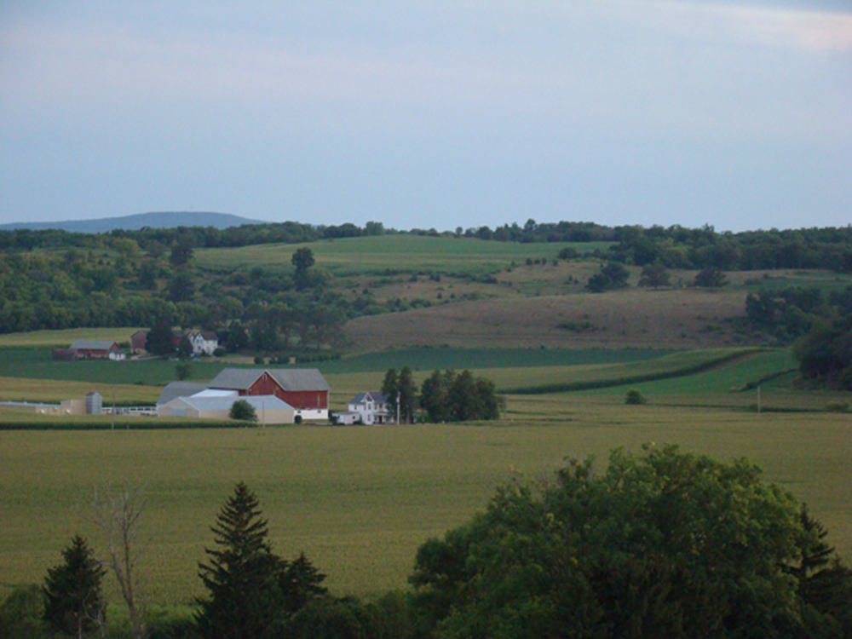
Plain
A plain is
large area of level or nearly level land

Slide 6
Escarpment
one side gently sloping
a ridge or hill with_____________________, the other a steep_____________________, formed by selective erosion in areas where the rock strata are tilted
is left after the softer bedrock was washed away around and beneath it.
cliff
Diagram an escarpment

Slide 7
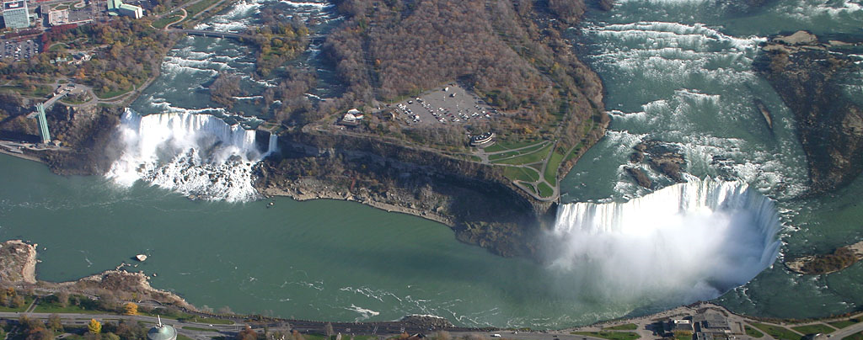
HINT:
Live from New York
What the… where is the what and how is the what?
What
Niagara Falls. 3 separate water falls 2 are in the U.S. and 1 in Canada
Where
The Niagara River. Two distinctive cities. Niagara Falls Ontario, Canada and Niagara Falls New York, United States of America.
How
The Niagara escarpment creates a very quick change in elevation on the Niagara River

Slide 8
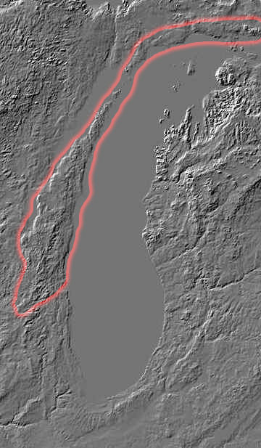
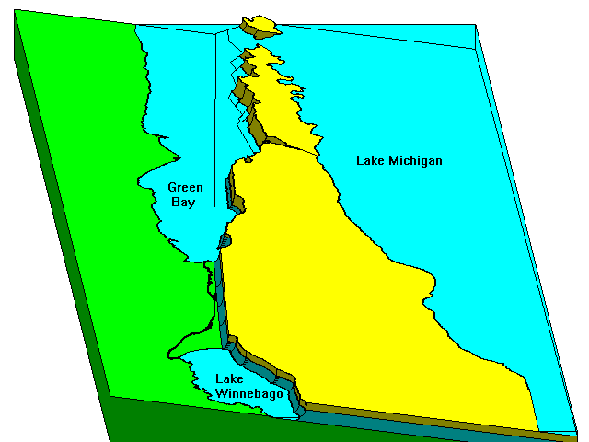
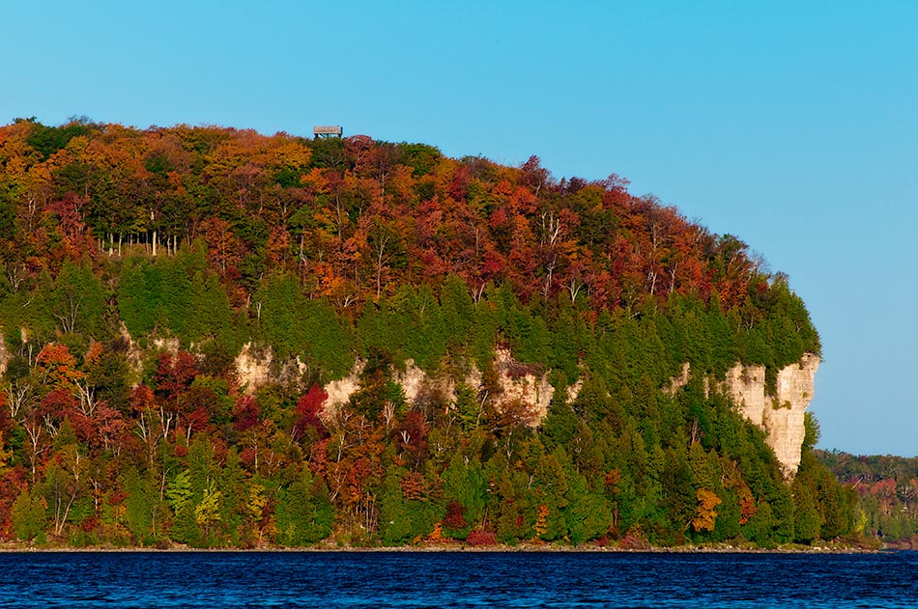
Yeah…big deal so what we are in Wisconsin
You see it but don’t realize it
Niagara Falls
Niagara Escarpment
On/Off

Slide 9
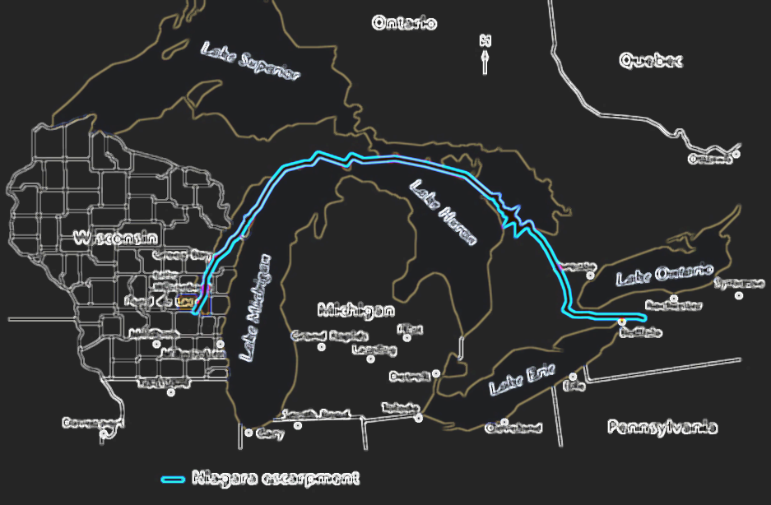
Yeah…big deal so what we are in Wisconsin
Based on our discussion, draw and label the connection of Wisconsin and New York

Slide 10
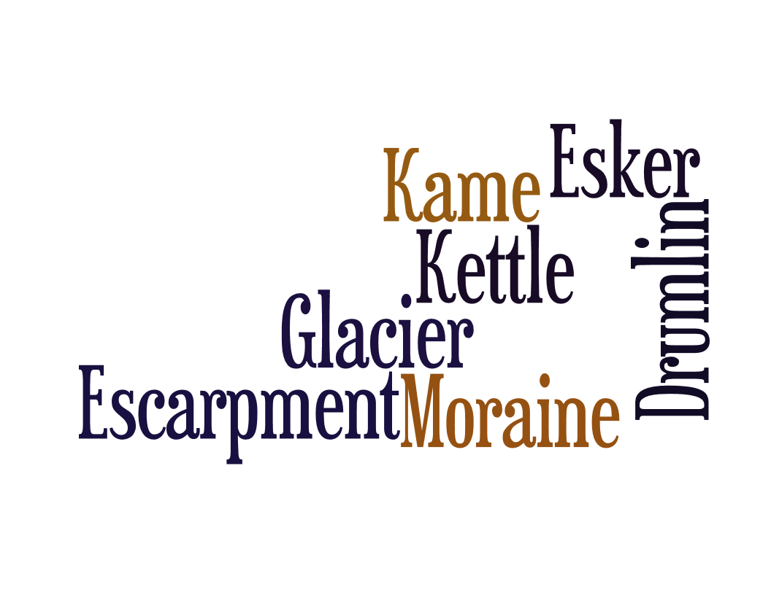
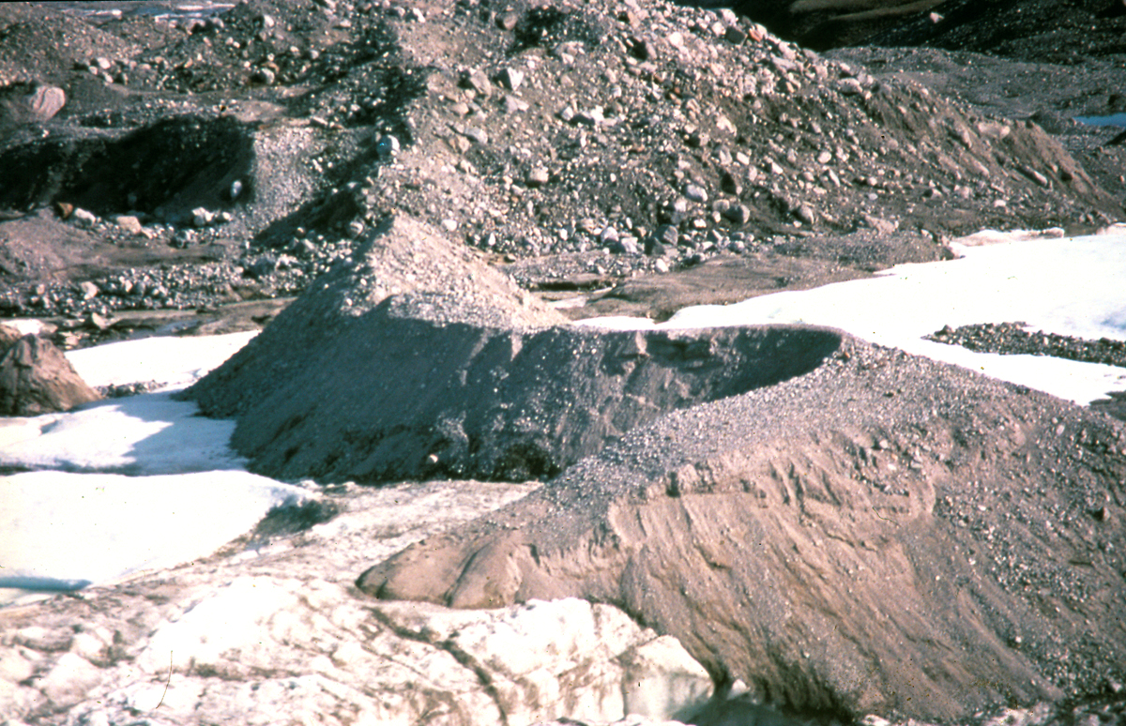
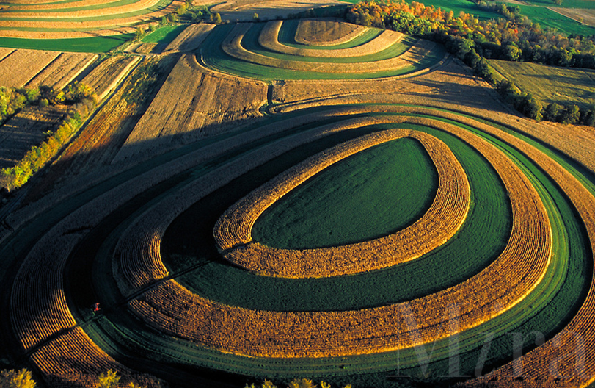
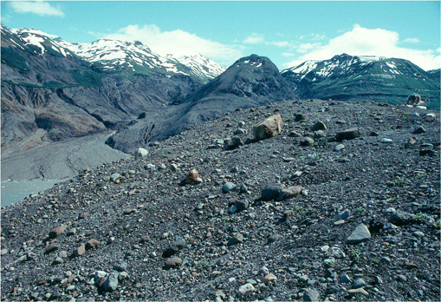
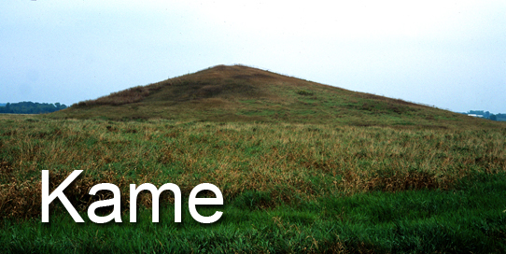
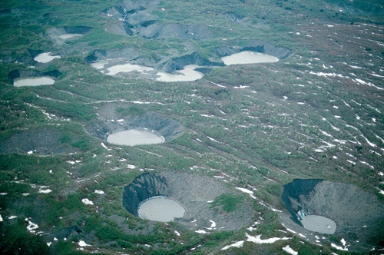

Slide 12
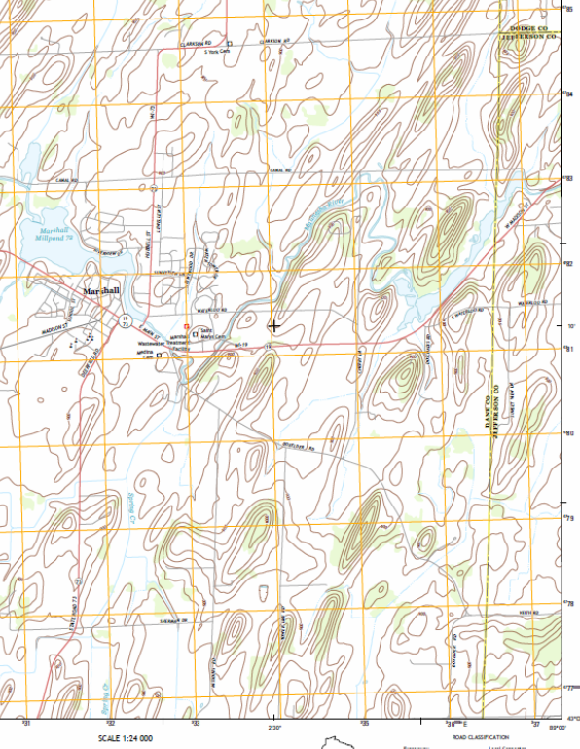
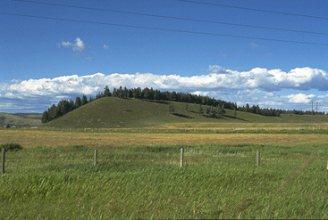
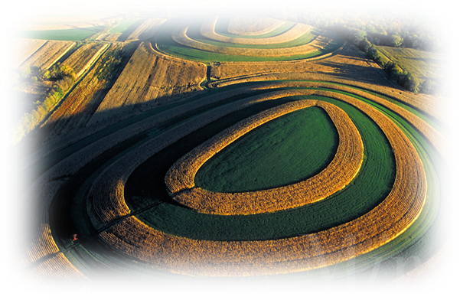
Drumlins
An _____________hill, largely composed of_______________, formed beneath a glacier or ice sheet and aligned in the__________________.
oval-shaped
glacial drift
direction of ice flow
They have one_________ and one___________ slope. The__________slope faces the direction from which the glacier__________, and the gentler slope faces the direction in which the glacier was advancing.
steep
gentle
steepest
started

Slide 13
Drumlins
An _____________hill, largely composed of_______________, formed beneath a glacier or ice sheet and aligned in the__________________.
oval-shaped
glacial drift
direction of ice flow
They have one_________ and one___________ slope. The__________slope faces the direction from which the glacier__________, and the gentler slope faces the direction in which the glacier was advancing.
steep
gentle
steepest
started

Slide 14
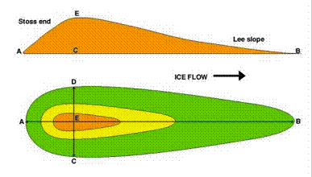
Draw an arrow in the direction of flow of the glacier
Diagram what a drumlin would look like from the side

Slide 15
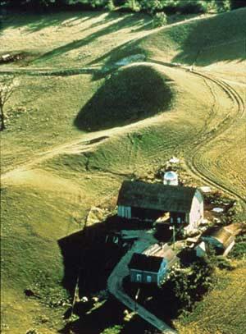
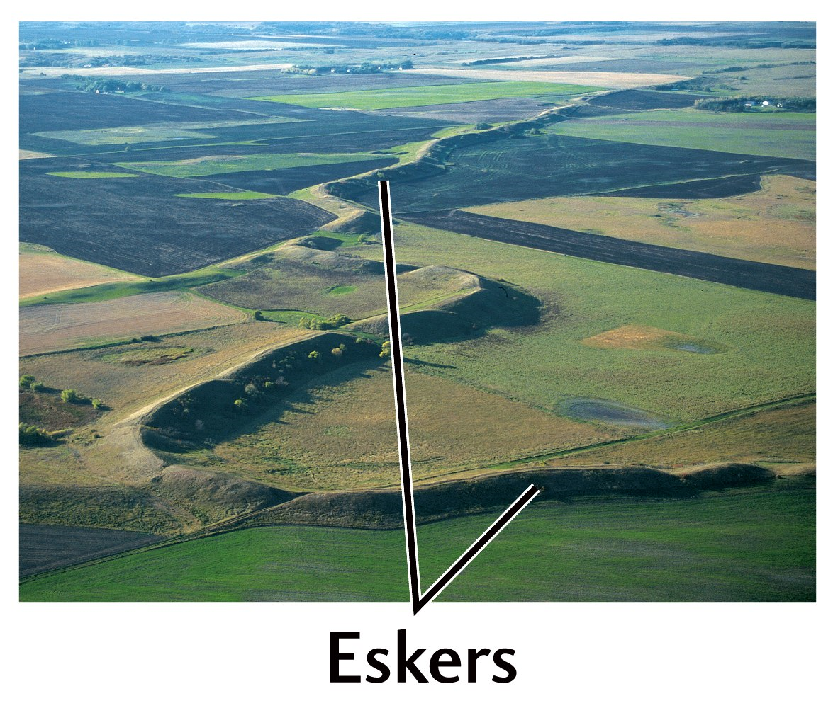
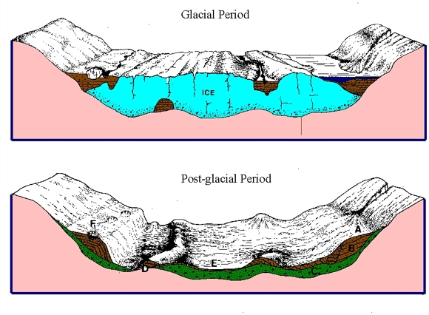
Esker
Esker is a modern term for the gaelic eiscir which means_____________
ridge of gravel
long narrow winding
They are _____________________ridges of layered gravel
stream/river beds
Eskers are actually________________________, deposited by glacial or stream activity ___________ of the glacier.
inside

Slide 16
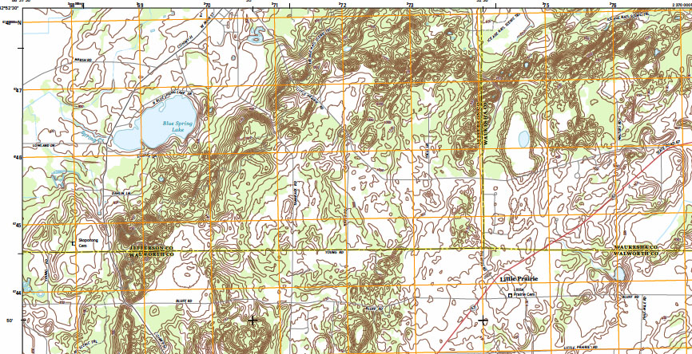
Circle and label 2 different eskers
Put a square and label a drumlin

Slide 17
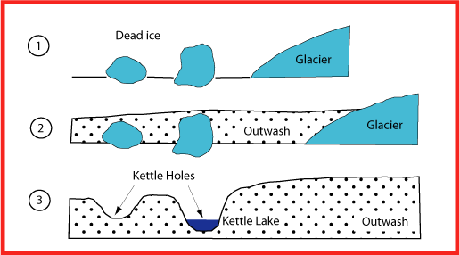
Kettle
A kettle is a _______created when buried blocks of __________melt out.
hollow
glacier ice

Slide 18
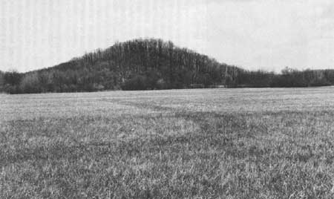
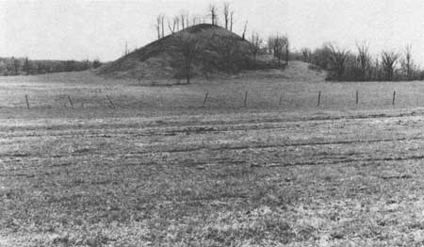
Kame
A kame is a _______ composed of ____________________formed by glacial __________.
hill
layered sand and gravel
meltwater
Kames often occur in association with _______ in kame and kettle topography. ______ may also occur between the kames.
holes
Eskers

Slide 19
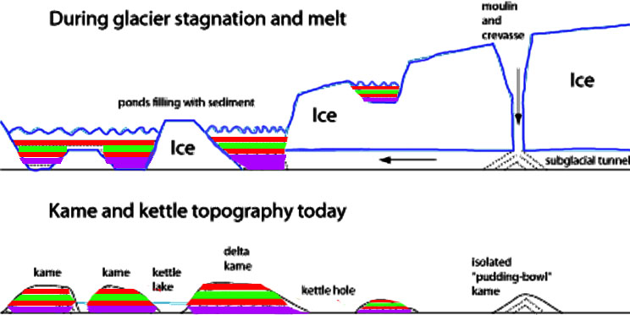

Slide 20
