Slide 1
Abbreviations and Equivalents
Foods and Nutrition
Mrs. Halverson
2013

Slide 2
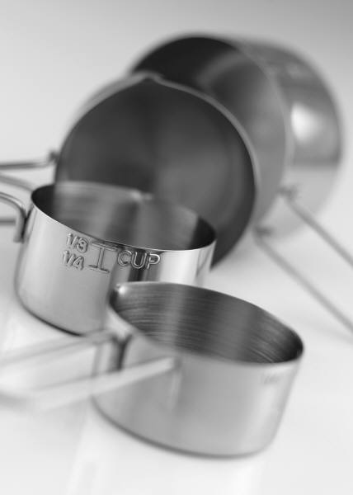
Abbreviations
Teaspoon = tsp. or t.
Tablespoon = tbsp. or T.
Cup = c. or C.
Gallon = gal.
Pint = pt.
Quart = qt.
Pound = lb. or #
Ounce = oz.
Square = sq.
Minutes = min.

Slide 3
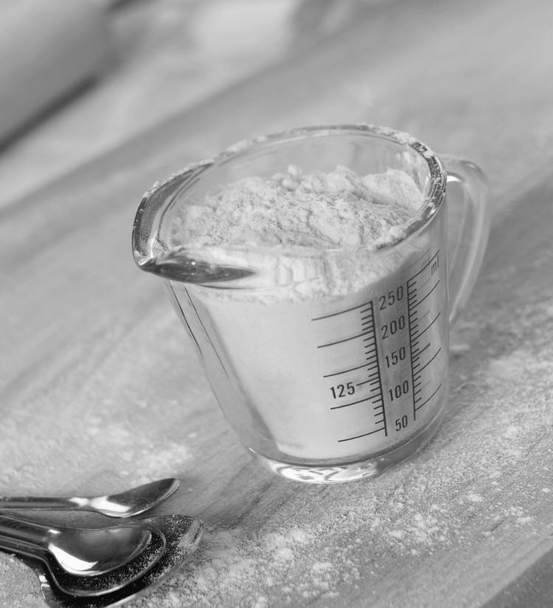
Equivalents
1 T.= 3 t.
1 c.= 16 T.
½ c.= 8 T.
½ c + ¼ c. = ¾ c.
1 c. = 8 fluid oz.
1/8 c.= 2 T.
1 gal.= 16 c.
1 gal. = 4 qt.
1 qt = 2 pt.
1 pt = 2 c.
1 lb. butter = 4 sticks
1 stick of butter = ½ c.
16 oz = 1 lb

Slide 4
Kitchen Math
Now it is YOUR turn to practice fundamental kitchen math skills!
Complete the equivalents worksheet.
Refer to your KEY to help with this!

