Slide 1
Absolute Dating
When you’re sure of the date based on chemistry

Slide 2
Recall
Relative Dating
Determining whether a rock is older or younger relative to another rock
Uniformitarianism
Superposition
Not dating cousins

Slide 3
Absolute Dating
Establishing the age of an object by determining the number of years it has existed
So, this is much more absolute
Ex. Jay-Z is older than Justin Bieber (Relative)
Bieber was born in 1994 (Absolute)

Slide 4
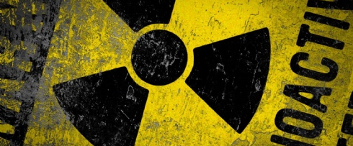
Method #1: Radioactive Decay

Slide 5
Atomic Review
Nucleus
Protons – Positive charge
Neutrons – Neutral Charge
Electron “cloud”
Negative charge
In most cases an atom has the same number of protons, neutrons and electrons
Ex. Carbon has 6 of all of these

Slide 6
Isotopes
Sometimes the
Isotopes
Isotopes: Atoms with the same number of protons but different numbers of neutrons
Most are stable and stay in original form, but some are unstable – they lose neutrons
These are radioactive

Slide 7
Beta Decay
Watch “Types of Decay”
Kahn Academy
6:10-10:15

Slide 8
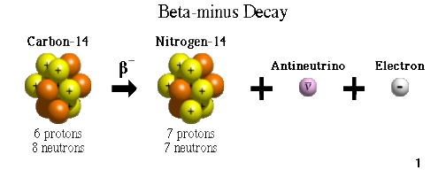
Radioactive Decay Basics (you just need to get the gist of this)
Beta Decay of Carbon 14
So basically, because of the loss of an electron, a neutron decays into a proton.
Why is this cool – Because this happens at a known rate – we can determine how old something is - absolutely
-1 electron
1 neutron becomes a proton

Slide 9
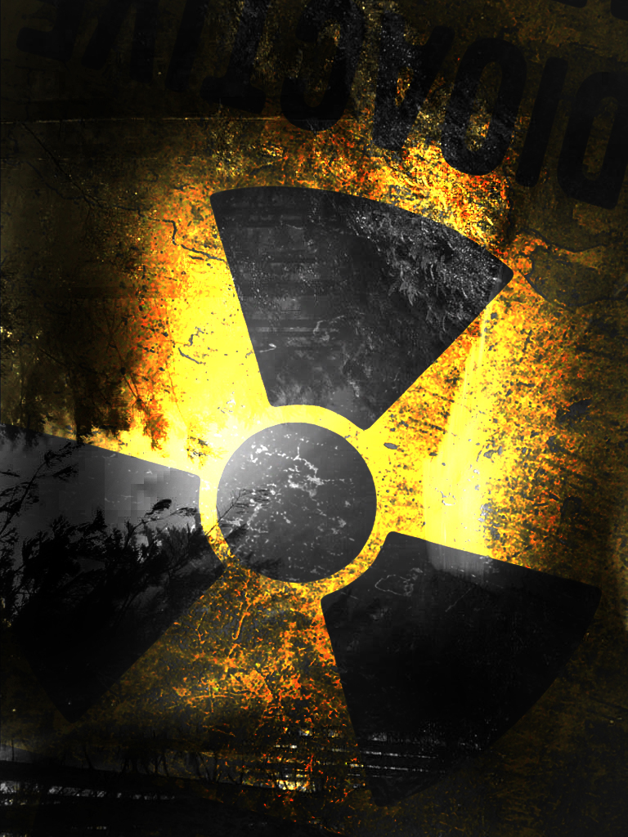
How do we use this to date rocks? Radiometric Dating
Parent Element
The name of the element you start with
Ex. Carbon 14
Daughter Element
The name of the element that the parent element turns into
Ex. Nitrogen
We take the current amounts and plug them into the known decay ratios
Half-Life is used to determine this

Slide 10
Half-Life - Not the video Game
Half-Life: The time needed for half of a sample of a radioactive substance to undergo radioactive decay

Slide 11
Half-Life
What is a half-life?
It is a unit of time. The amount of time needed for 50% of an atom to decay to another.
The amount of time to reduce from 1 to ½ and then from ½ to ¼ is equal.
1/1
0 years
1/2
10,000 years
1/4
20,000 years
After every half-life, the amount of parent material decreases by one-half

Slide 12
Another Perspective

Slide 13
Carbon-14
Very common form of dating
Measurement of carbon -14 compared to the amount of stable carbon-12
Used for things as old as 50,000
Half life is 5,730 years
Limitation – it can only be used for things containing carbon (living things)
Final Explanation

Slide 14
Potassium Argon
Commonly used to date Rocks
Other methods are also used for rocks
Potassium decays into Argon
Good for measurements up to 100,000 years

Slide 15
Review
Absolute Dating
Determines exact age of something
Isotope
Atoms of the same element with different number of neutrons
Half life
Unit of time need for half of a substance to decay

Slide 16
More Review
Why must the rate of decay be constant in order for radiometric dating to be accurate?
Which method of dating would you use to date rocks in the quarry? An old piece of leather?

