Slide 1
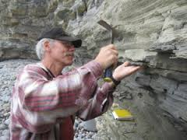
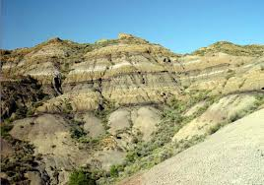
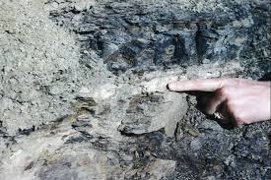
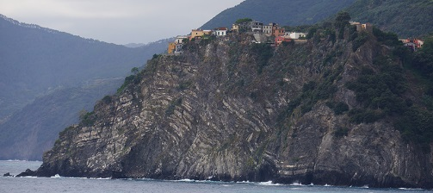
History of Earth MS-ESS1-4. Construct a scientific explanation based on evidence from rock strata for how the geologic time scale is used to organize Earth’s 4.6-billion-year-old history.
LT: I can interpret rock strata scenarios and develop an explanation for how the rock layers formed.

Slide 2
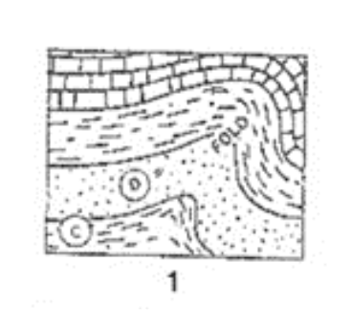
Youngest
Oldest

Slide 3
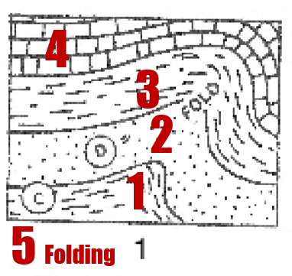
Youngest
Oldest

Slide 4
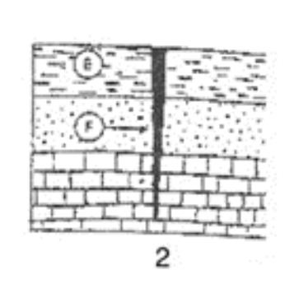
Youngest
Oldest

Slide 5
Youngest
Oldest

Slide 6
Youngest
Oldest

Slide 7
Youngest
Oldest

Slide 8
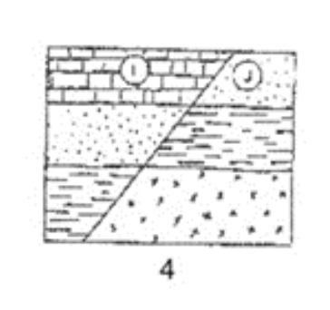
Youngest
Oldest

Slide 9
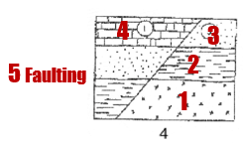
Youngest
Oldest

Slide 10
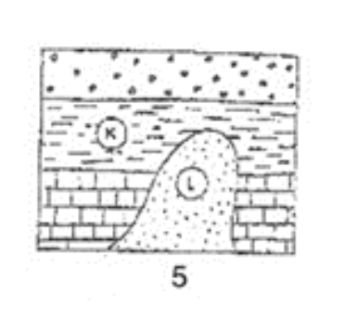
Youngest
Oldest

Slide 11
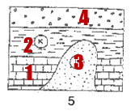
Youngest
Oldest

Slide 12
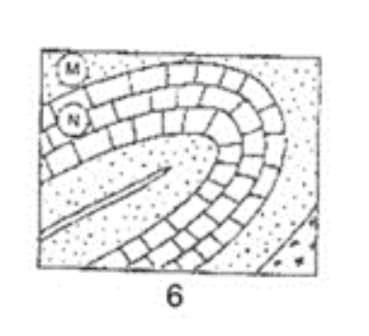
Youngest
Oldest

Slide 13
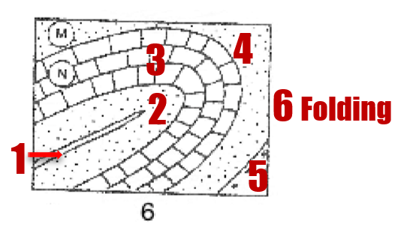
Youngest
Oldest

Slide 14
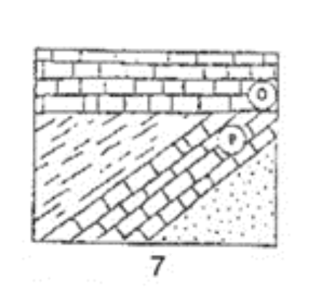
Youngest
Oldest

Slide 15
Youngest
Oldest
What process is missing from this answer key and where should it go?

Slide 16
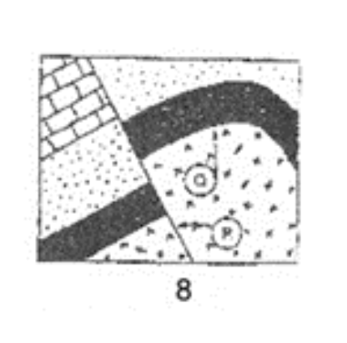
Youngest
Oldest

Slide 17
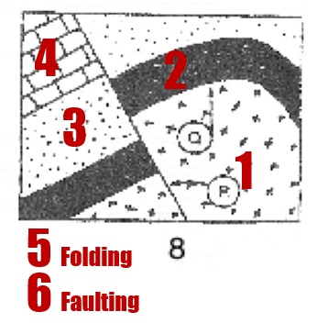
Youngest
Oldest

Slide 18
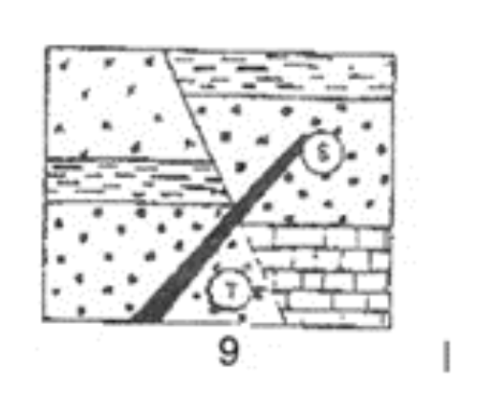
Youngest
Oldest

Slide 19
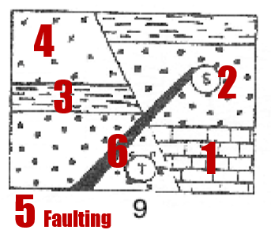
Youngest
Oldest

Slide 20
Youngest
Oldest

Slide 21
Youngest
Oldest
Erosion
H
D
Erosion
G
Erosion
F
C
Erosion
E
B
A

Slide 22
Youngest
Oldest

Slide 23
C (Erosion)
A
Erosion
Uplift/tilting
J
G
F
Erosion
H
Folding
I
B
E
D
Youngest
Oldest

Slide 24
Are you ready for a challenge? Try this one!
http://facweb.bhc.edu/academics/science/harwoodr/geol101/labs/dating/index.htm

Slide 25
NOW CHALLENGE YOUR LAB PARTNERS.
FIGURE OUT THE CORRECT ORDER OF THE EVENTS BY WRITING THE ORDER (OLDEST TO YOUNGEST) DOWN ON SCRAP PAPER. WHEN EVERYONE IS FINISHED THEN FORWARD TO THE NEXT SLIDE TO GET THE CORRECT ANSWER.
Just write the letters that are given in the scenarios.

Slide 27
Oldest to youngest: C, E, D, A, B

Slide 29
Oldest to youngest: E, B, C, D, A

Slide 30
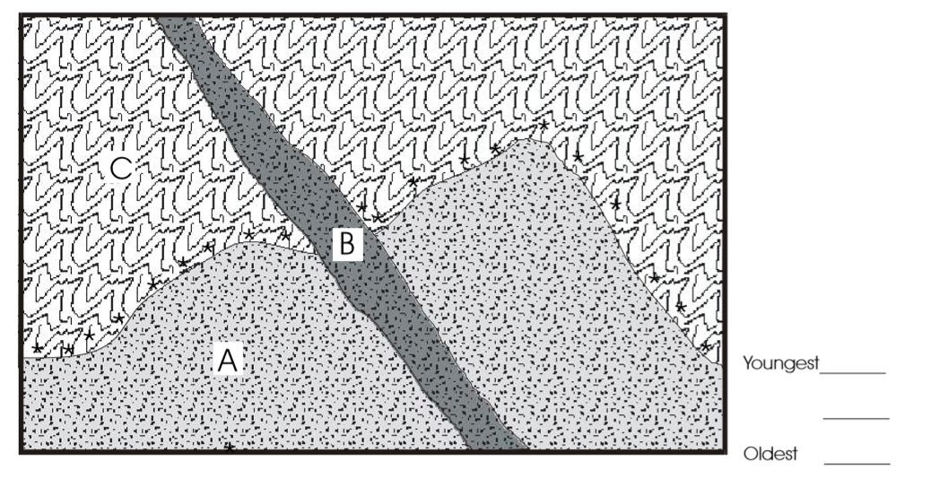

Slide 31
Oldest to youngest: C, A, B

Slide 33
Oldest to youngest: G,C,A,F,B,H,D,I,E

Slide 35
Oldest to youngest: D,H,A,C,G,F,I,B,E

Slide 37
Oldest to youngest: O,H,B.L.J,A,F,M,D,G,N,E,I,C,K

Slide 38
Now here you go!!
http://www.sciencecourseware.org/VirtualDating/files/1.0_ClocksInRocks.html

