Slide 1
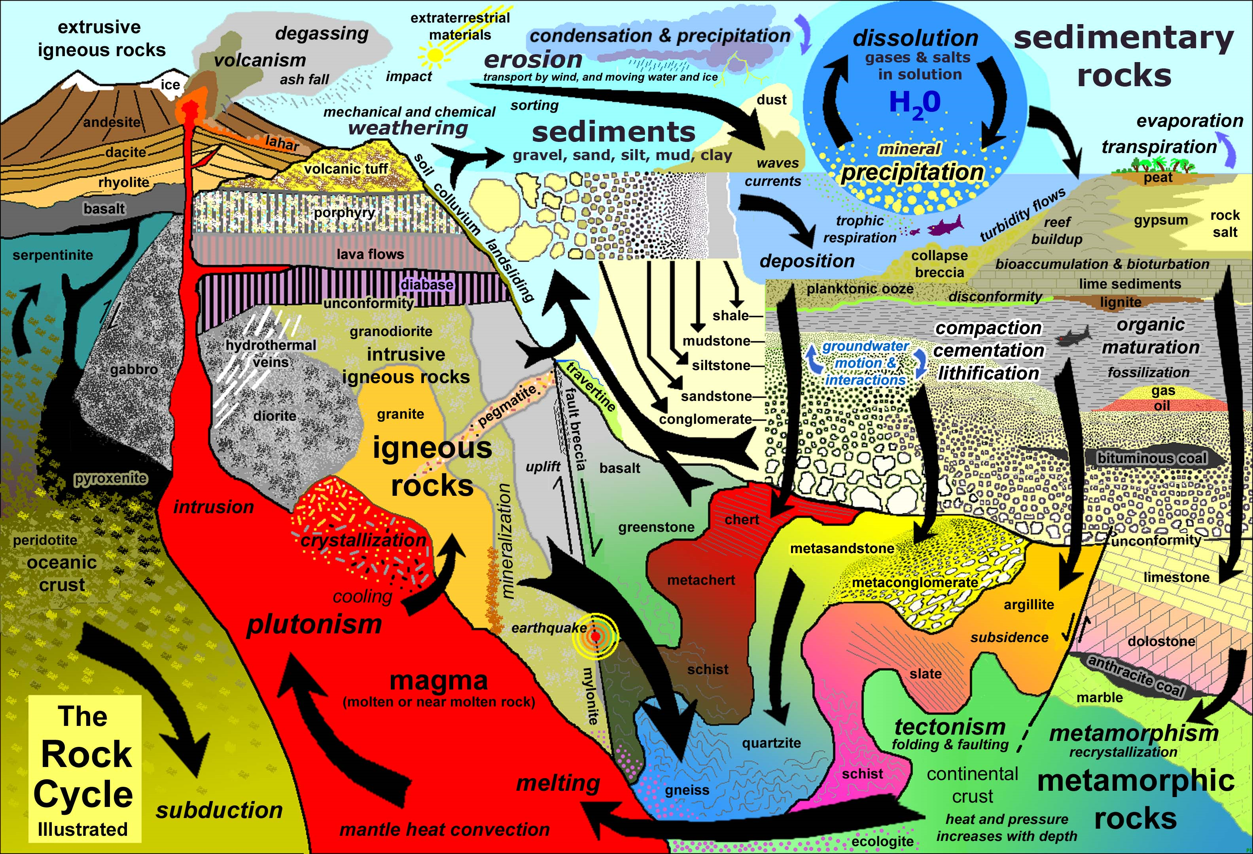
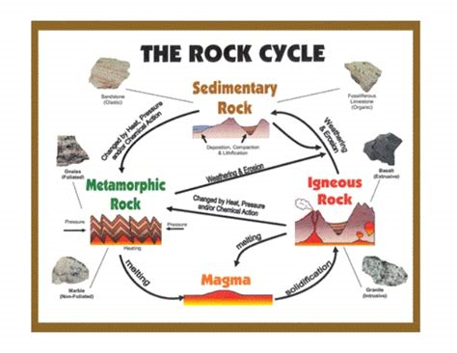
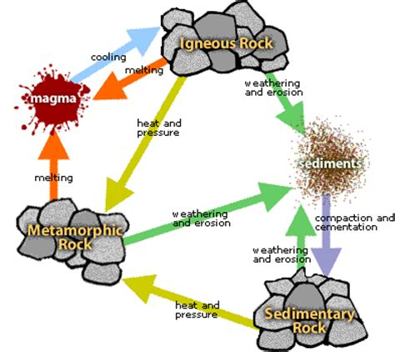
Rock Cycle UNO

Slide 2
Day 1:
Read about the rock cycle in the textbook Inside the Restless Earth
Chapter 2 section 1 p. 28-34
Pick 3-4 people to be in your group (these will not be the people you be with in Rock Band)
On an index card, have each person in your group write their name. Turn this in to the teacher.

Slide 3
Day 2-3
Assign each person in your group a rock type
Take notes on that type for the team
Present your information to your team. Have them listen and take notes from your presentation
Tape on ISN p.44

Slide 4
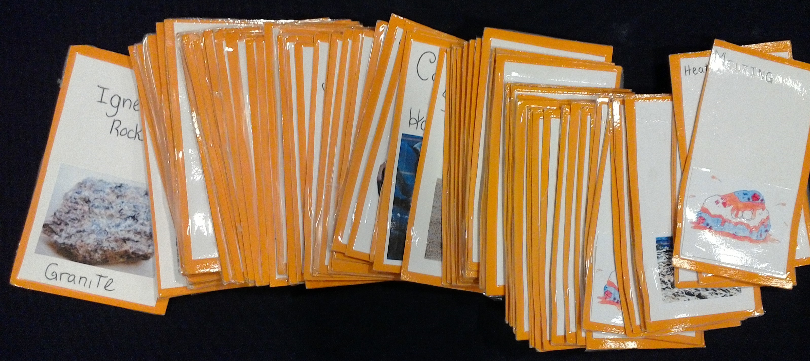
Day 3 - 4
Assign each team member a list of cards to make
Decide on a theme (general look) so that all cards are uniform

Slide 5
Something to keep in Mind
Deck construction is like a mini research project. You can increase difficulty by changing the complexity of the cards. FOR EXAMPLE:
Igneous Rock | Weathering and Erosion
Simple Deck: | Simple Deck:
Igneous Rock | Rock Wears Away
Advanced Deck: | Advanced Deck:
Granite | Abrasion
Basalt | Exfoliation
Obsidian | Ice-Wedging
Pumice | Oxidation

Slide 6
Card Requirements:
Each card must have a title and a picture
All the cards are the same size
All the back sides must be identical
Front sides cannot be seen through the backside

Slide 7
The cards:
You will make 68 cards:
12 Rock Wears Away | 4 Sedimentary Rock
12 Melting | 4 Metamorphic Rock
12 Heat and Pressure | 4 Sediments
4 Cementing and Compacting | 4 Magma and Lava
4 Cooling and Hardening | 2 Wild
4 Igneous Rock | 2 Reverse

Slide 8
Day 5

Slide 9
How to Play:
Each player starts with 7 cards.
First player is to the left of the dealer. Gameplay usually goes in a clockwise direction.
Try to place a card in the discard pile by what step comes next in the rock cycle.
If they do not have a card to play they will pick one up from the draw pile. If that card can be played please do otherwise the game moves to the next person.
Game continues until a player has one card left. They must then say “UNO”. If they do not before another card is played, they must draw two new cards.
Special Cards
Wild Card: This card can be played at any time, and the person who put it into play can restart the cycle at any point they choose.
Reverse: This card does not reverse the direction of play, but instead makes it so players must now play cards that come before the current card instead of after.

