Slide 1
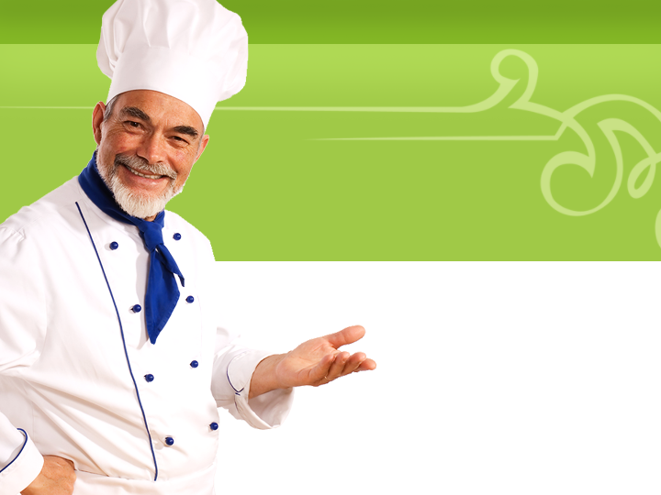
Practical Lab
Final Exam
Mrs. Halverson

Slide 2
Purpose
Demonstrate your creativity, organizational, and food preparation skills through the planning and execution of menu items.

Slide 3
Plan Menu
Teams must create a complete meal
Appetizer or dessert
Entrée- protein
Starch or vegetable side dish
Your team should also incorporate the “secret ingredient” into your menu.
Your Description Goes Here

Slide 4
Requirements
Find recipes online- copy the links
Fill out a mise en place sheet
Order all ingredients for Mrs. Halverson on a market order sheet
If items can not be purchased by Mrs. Halverson the team is responsible for purchasing the item!
Your Description Goes Here

Slide 5
Menu
Write up a description of each of your menu items (as you would see on a menu) on the powerpoint
BE DESCRIPTIVE!
Your Description Goes Here

Slide 6
Food Costing
Food costs must be calculated for each individual item found on the main entrée (protein, starch or vegetable)
Food cost must be typed on the official costing template found on my website
Your Description Goes Here

Slide 7
Main Entrée Preparation
Each team will prepare two identical main entrée plates with protein and side dish.
Servings for the entrée are:
4-6 oz chicken breast
½ lb ground beef
Take a picture of your final plate to be included in the powerpoint
Your Description Goes Here

Slide 8
Appetizer/Dessert Preparation
Each team will prepare an appetizer or side dish using the “secret ingredient”
All appetizers and desserts will be shared with the entire class
Take a picture of one serving of your appetizer or dessert to be included in your powerpoint
Your Description Goes Here

Slide 9
Make it WOW!
Your Description Goes Here
Worth our Wait!

Slide 10
Make it WOW! HOW?
Color
Texture
Flavor
Shape
Temperature
Your Description Goes Here

Slide 11
Make it WOW! COLOR
Color appeals to the eye and stimulates the appetite.
How could we change this meal to be more colorful?
Your Description Goes Here

Slide 12
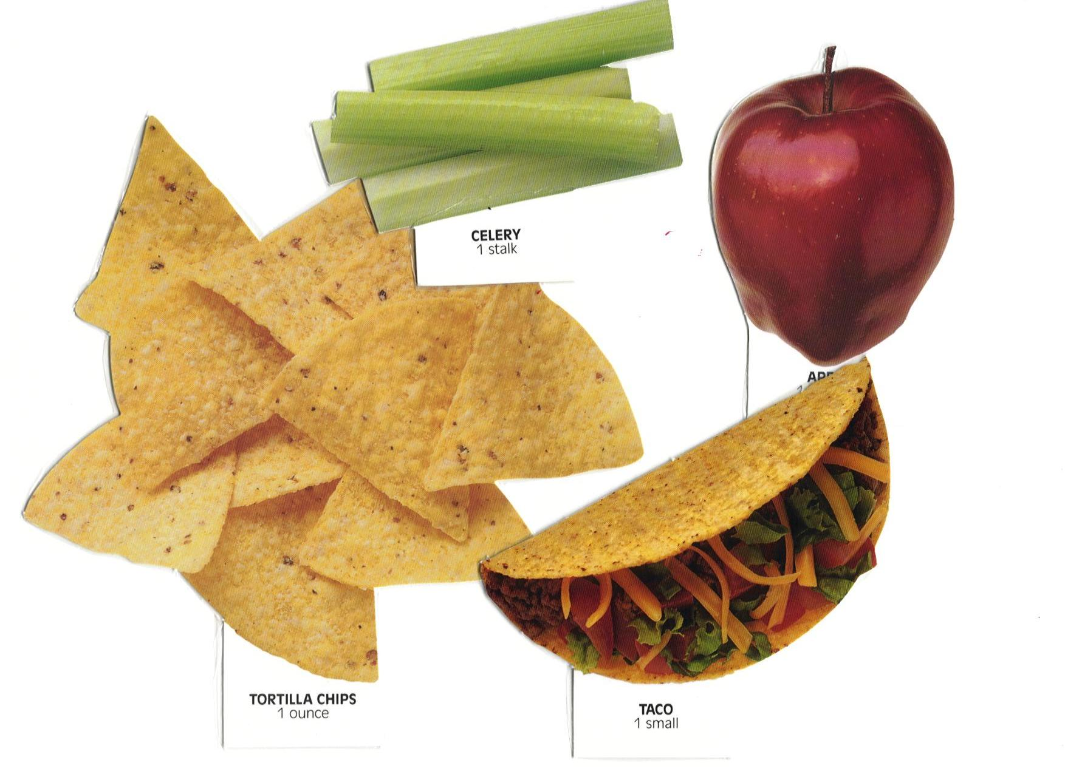
Make it WOW! TEXTURE
Texture variety makes meals more enjoyable to eat.
How can we change this meal to include a variety of textures?
Your Description Goes Here

Slide 13
Make it WOW! FLAVOR
Make a point of balancing strong flavored foods with those that are more subtle.
How can we change the meal to include a variety of flavors?
Your Description Goes Here

Slide 14
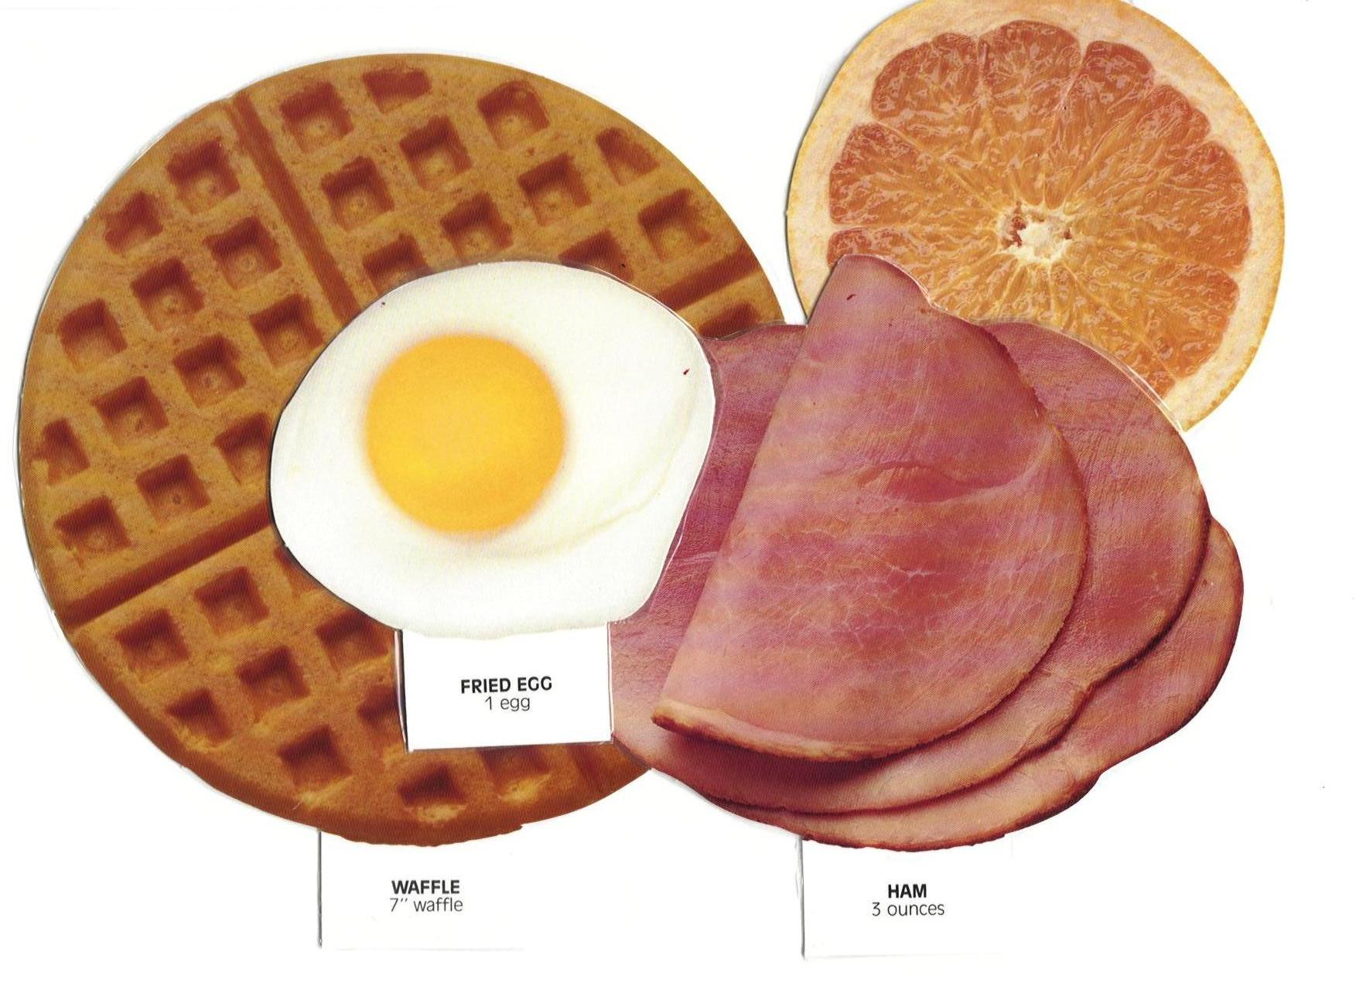
Make it WOW! SHAPE
The shape and size of foods on your plate can affect how inviting they look.
How can we change the meal to include a variety of shapes?
Your Description Goes Here

Slide 15
Make it WOW! TEMPERATURE
Most people enjoy a balance of hot and cold foods in their meals.
How can we change the meal to include a variety of temperatures?
Your Description Goes Here

Slide 16
Final Presentation
Share your menu, recipes and pictures of your final items using the powerpoint template on May 30th.

