Slide 1
Student Destiny Discover Tool at Greenville Middle School
Access from anywhere: school, home, traveling

Slide 2


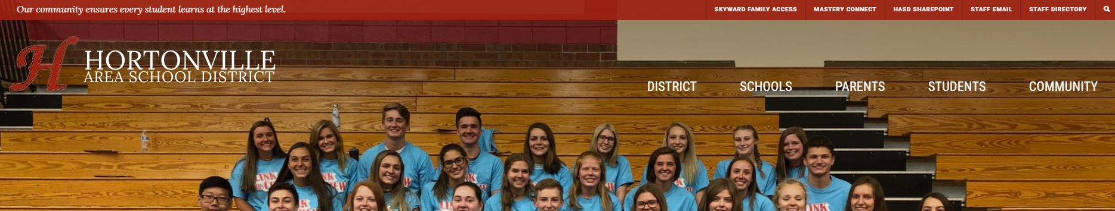
Let’s Get Started (from a desktop or laptop):
* Open a CHROME internet browser or try the new Microsoft Edge
* Go to the HASD website at www.hasd.org and hovering over “Schools”, choose “Greenville MS” for GMS.

Slide 3
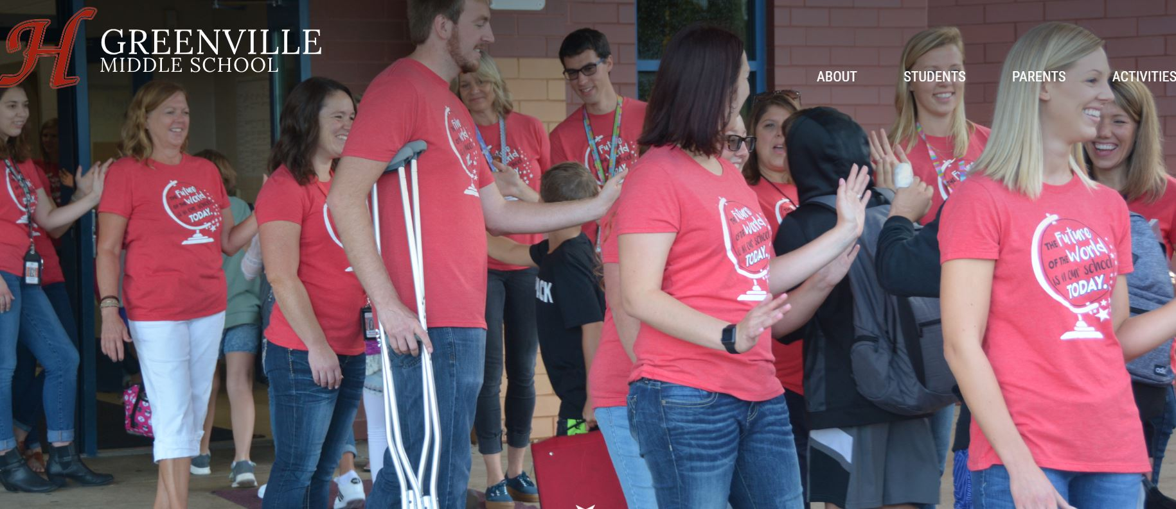
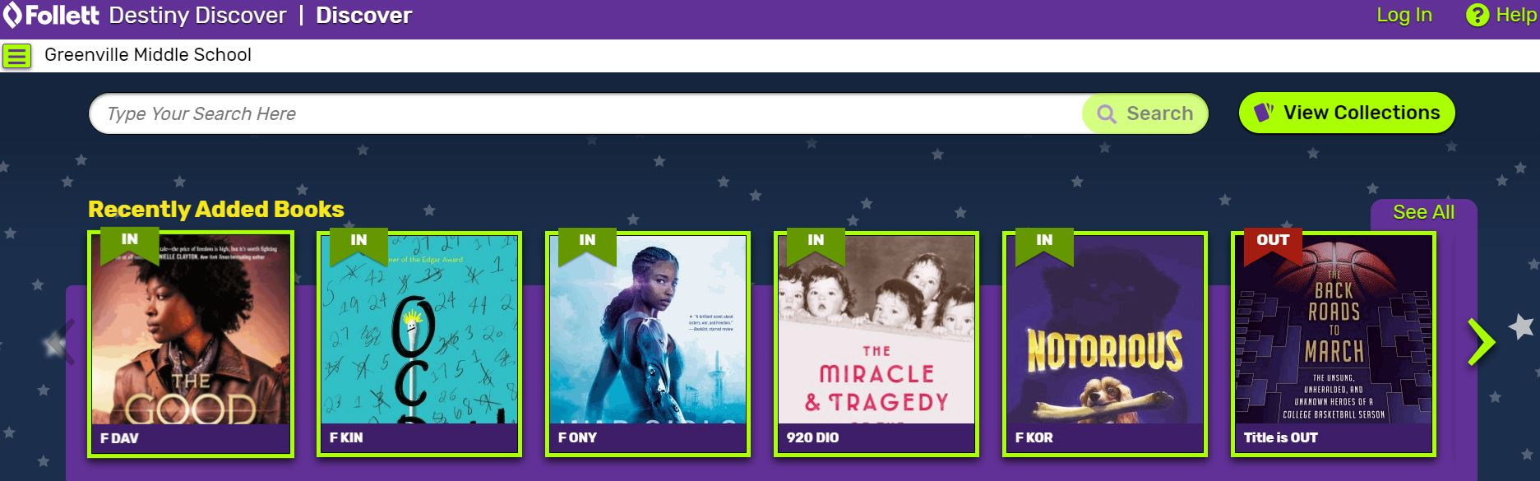
Once you choose the Schools tab and choose Greenville MS to go to Greenville Middle School’s Homepage, you can…
Hover over “Students” and click on “Ebook and Destiny Discover Link”
The Destiny Discover homepage looks like this:

Slide 4
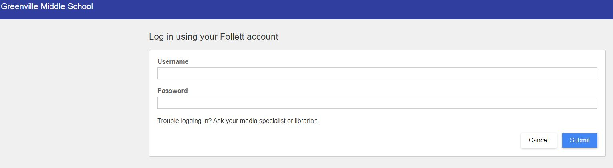
Click on “Log In” in the upper right hand corner. On the log in page, you need to enter your user name and password exactly the same as you use to log in to the computers at school: (If it does not work, you must see Mrs. Wagner to fix your log in).
Username: first and last name, no spaces
Password: the same password you use at school
** Press “submit”

Slide 5
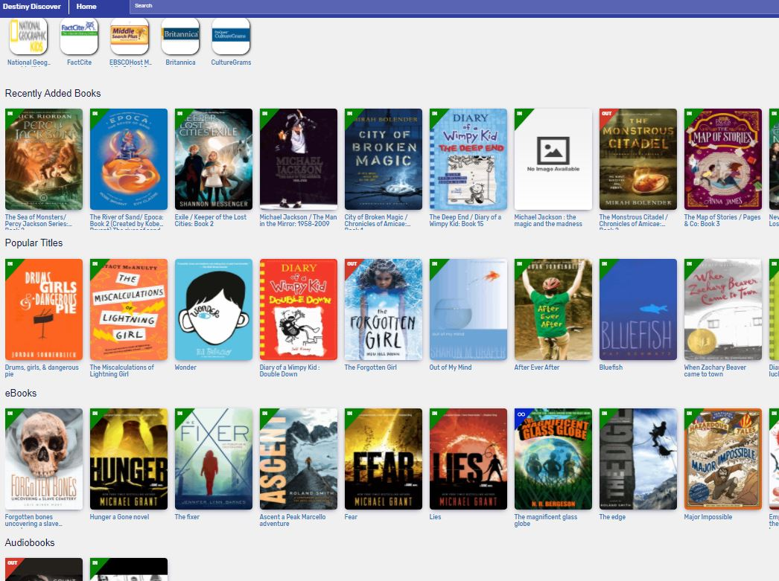
Destiny Discover home screen once you’ve signed in:

Slide 6
* Learning Links Icons (Resource websites)
* Recently Added Books (Most recently added)
* Popular Titles (Books that get checked out a lot)
* Ebooks (one checkout at a time for up to a week)
* Audiobooks (same checkout as eBooks)
* Learning Links
* Collections (High interest collections of books, resources, websites, information)
* Lightbox (Teacher resource)
* Interactive Ebooks
* Topics (This is on the site but not very useful right now)
The Order of the Resources on the Destiny Discover Home Page:

Slide 7
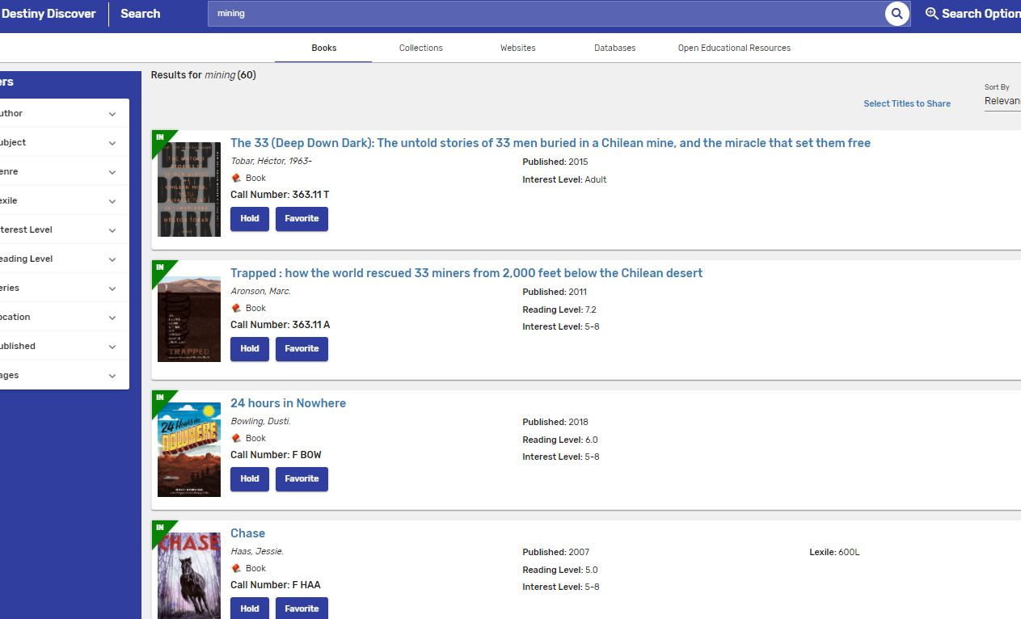
Researching a topic
Begin by typing your topic into the search window at the top of the main page: Example: “mining”.
The first thing that comes up is Books (the far left tab) related in any way to the topic of “mining”.
When you scroll down the list, there are both fiction and non-fiction books related to mining. Since this is a broad topic, you might see both “trapped miners” and “Gold rush mining”. If you are just interested in one aspect of a topic, narrow your search and you will get fewer resources.

Slide 8
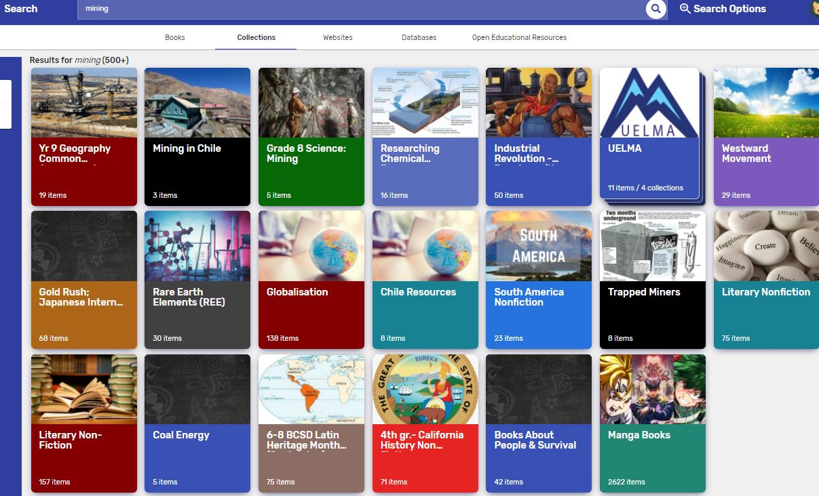
Click the next tab second from left: “Collections”
This is an excellent resource for finding a wide variety of information that someone else has already researched. Their collection may be just what you’re looking for or give you a starting place for your research topic. These are not just created from our school but from many different Destiny Discover users.

Slide 9
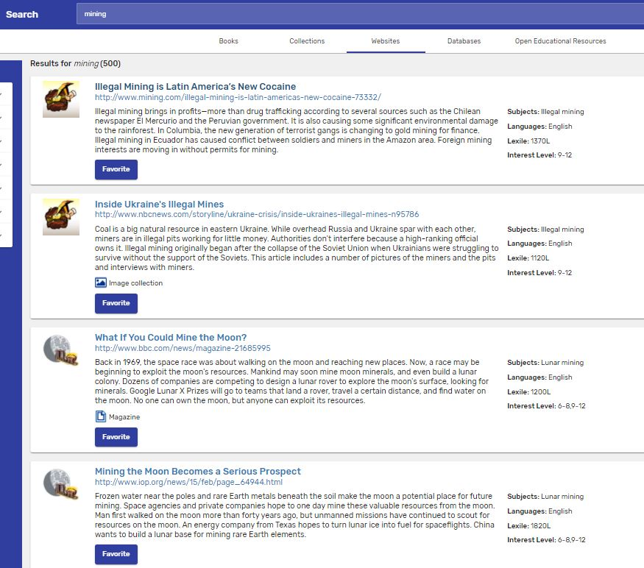
Research Using Websites (which is Webpath Express – a website filter to provide reliable resources)
Click on the next tab over: Websites.
This will give you many website resources on your topic and generally provides a wide variety of websites. They are vetted by a paid resource: Webpath Express, so they should be reliable resources.
Again, you may have to refine your search to narrow the topic and get more precise results.

Slide 10

The next tab is Databases
This is incomplete at this time.

Slide 11
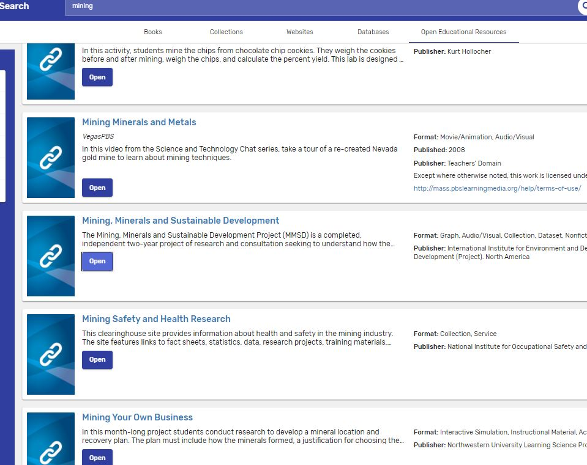
The last tab is Open Educational Resources –
Mostly used by educators
Very good resource if you are looking for information to teach your class
You really need to refine your search to get the information you want. It will pull up anything related to that topic.

Slide 12
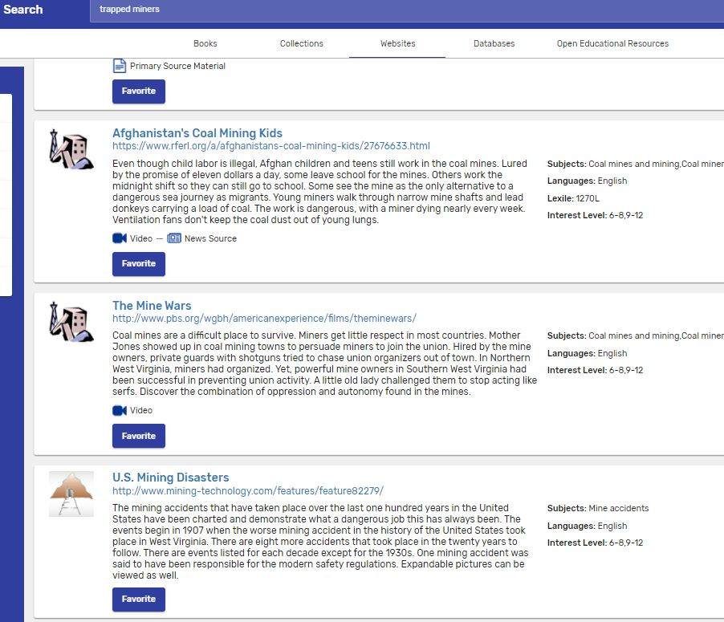
Citing Your Sources with Destiny Discover
This is absolutely one of the best tools that Destiny Discover provides.
Gives exact ML8 citations.
EASY to use.
“One-stop shopping” if you do all of your research from Destiny Discover with a variety of resources.
Make sure that you are logged into Destiny Discover
Click the “favorite” button below any resource that you are going to use for your research. In my mining example, I chose 5 resources, a mix of books and website articles.
When done, click on 3 lines in the upper left corner, next to “Destiny Discover”

Slide 13
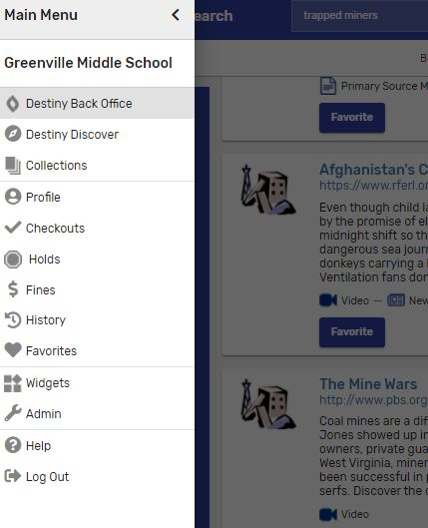
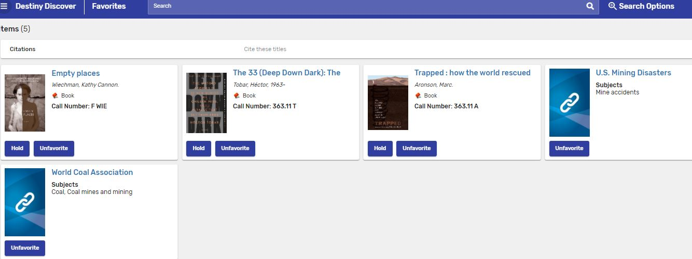
Citing Your Citations - Continued
When your favorites appear, click on the words, “Cite these titles” in the upper middle.
What you will see when you press the 3 lines. Choose “Favorites”.

Slide 14
Your Citations

Slide 15
Destiny Discover can provide you with a lot of information if you take the time to get to learn it.
We hope you find this a very useful tool!

