Slide 1
ebooks
Accessing eBooks at North Greenville Elementary School in the Library, Classroom, at Home, or Anywhere.

Slide 2
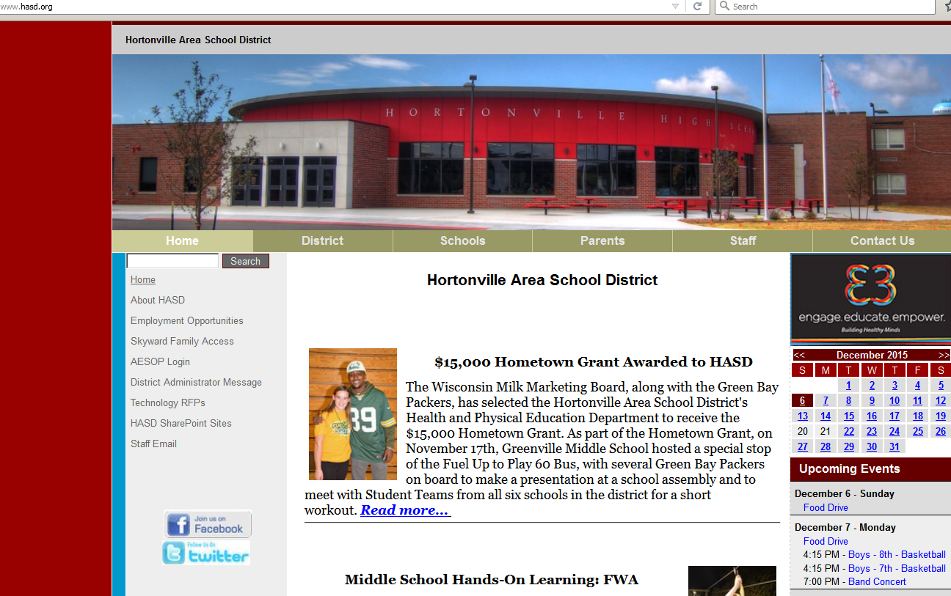
Let’s Get Started:
Log onto the computer and open Internet Explorer and open the HASD website

Slide 3
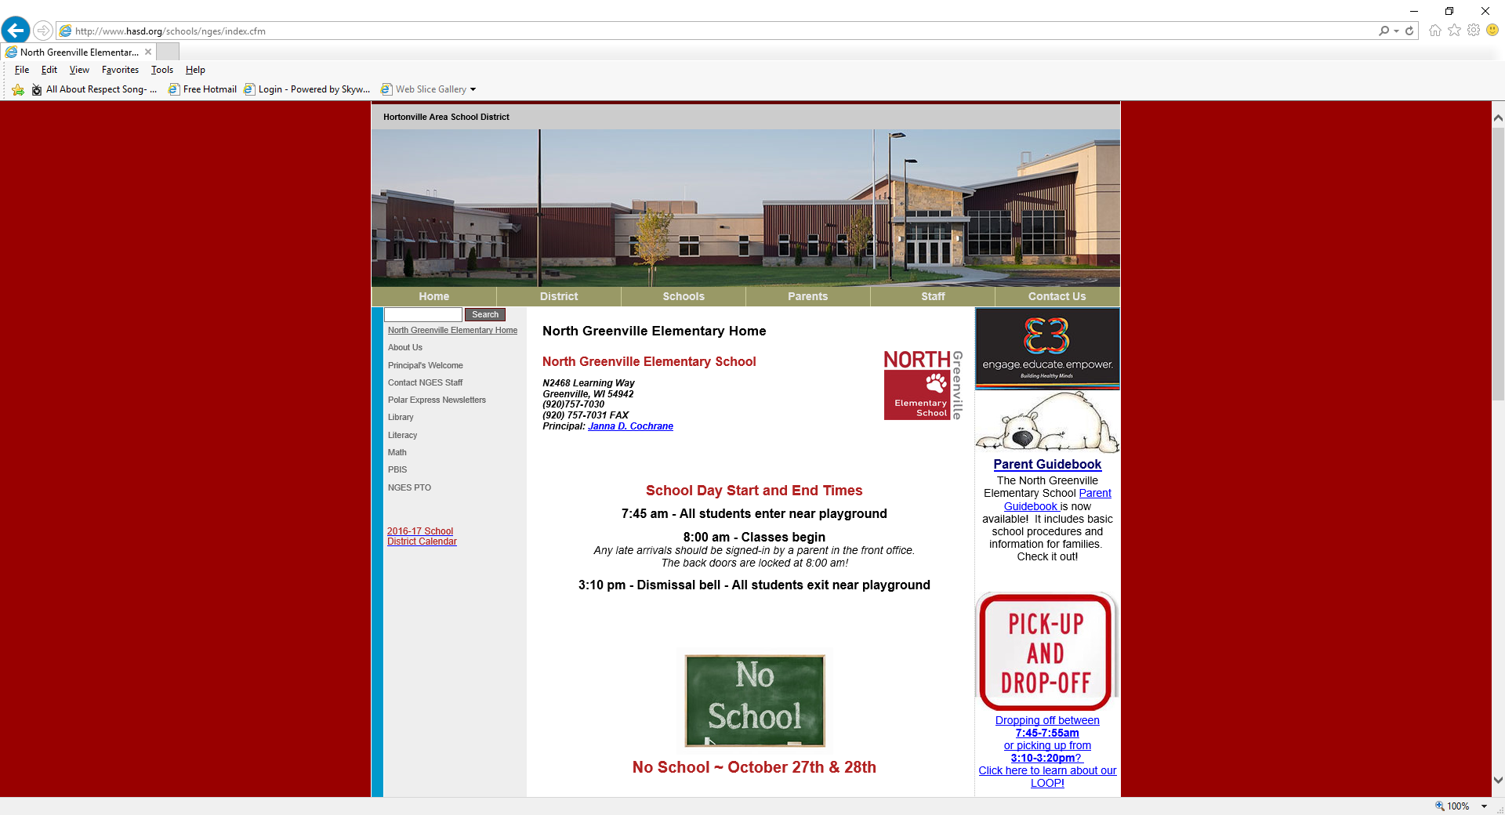
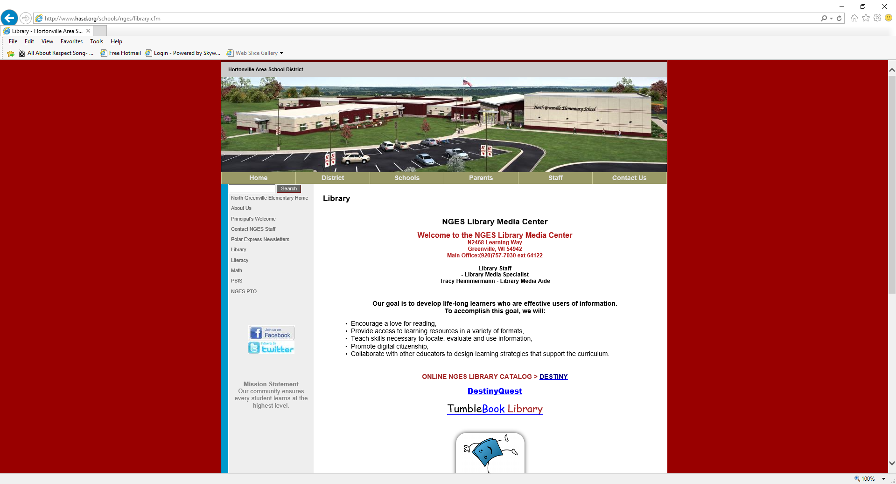
*Go to the North Greenville Elementary School website.
*Go on the Library website from the left column.
*Click on Destiny Discover in the middle of the page.

Slide 4
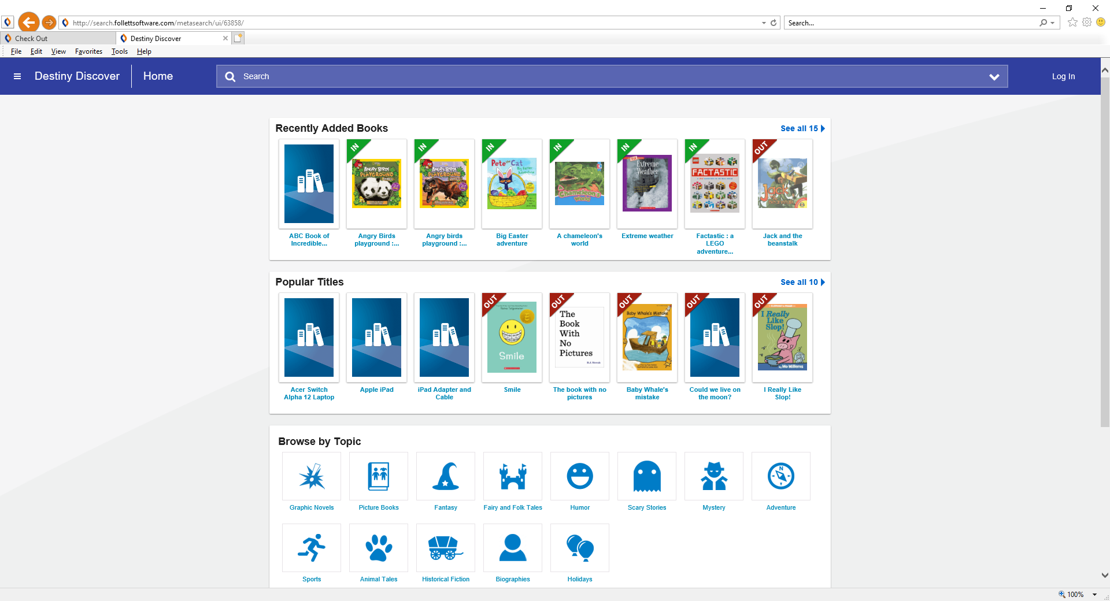
Logging into Destiny Discover
Destiny Discover
Click on login
on THE top

Slide 5
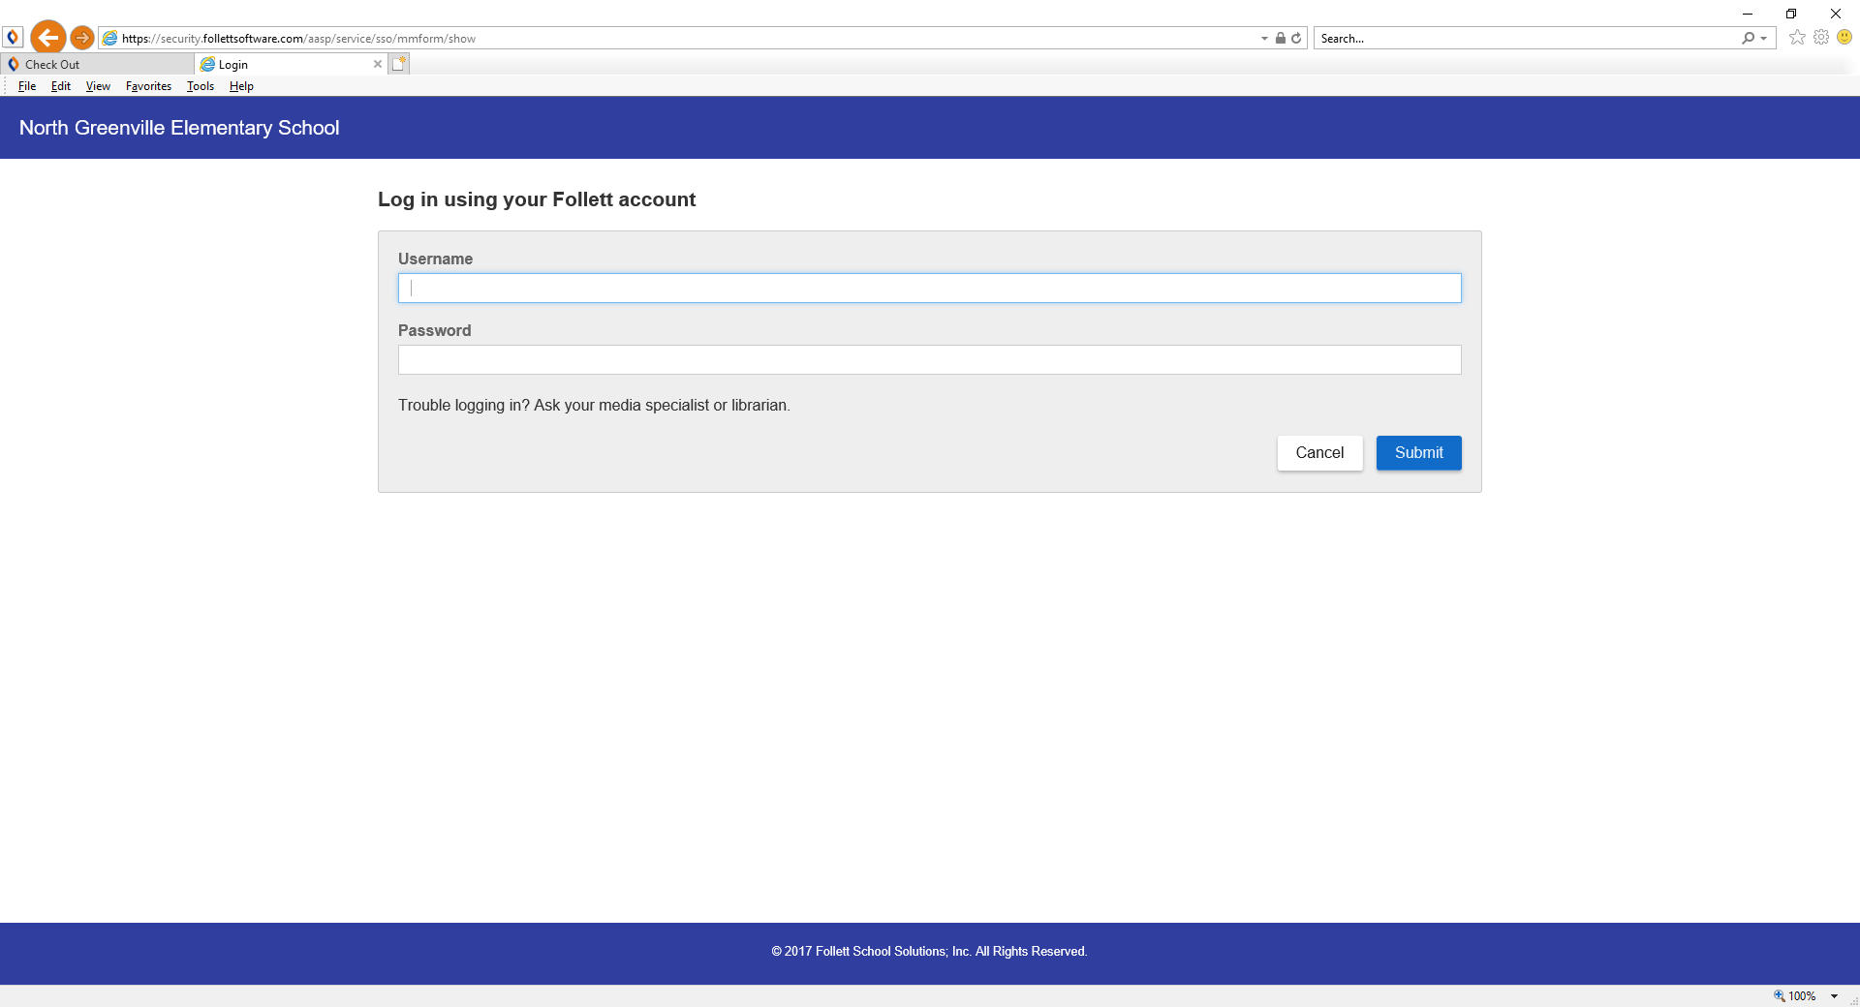
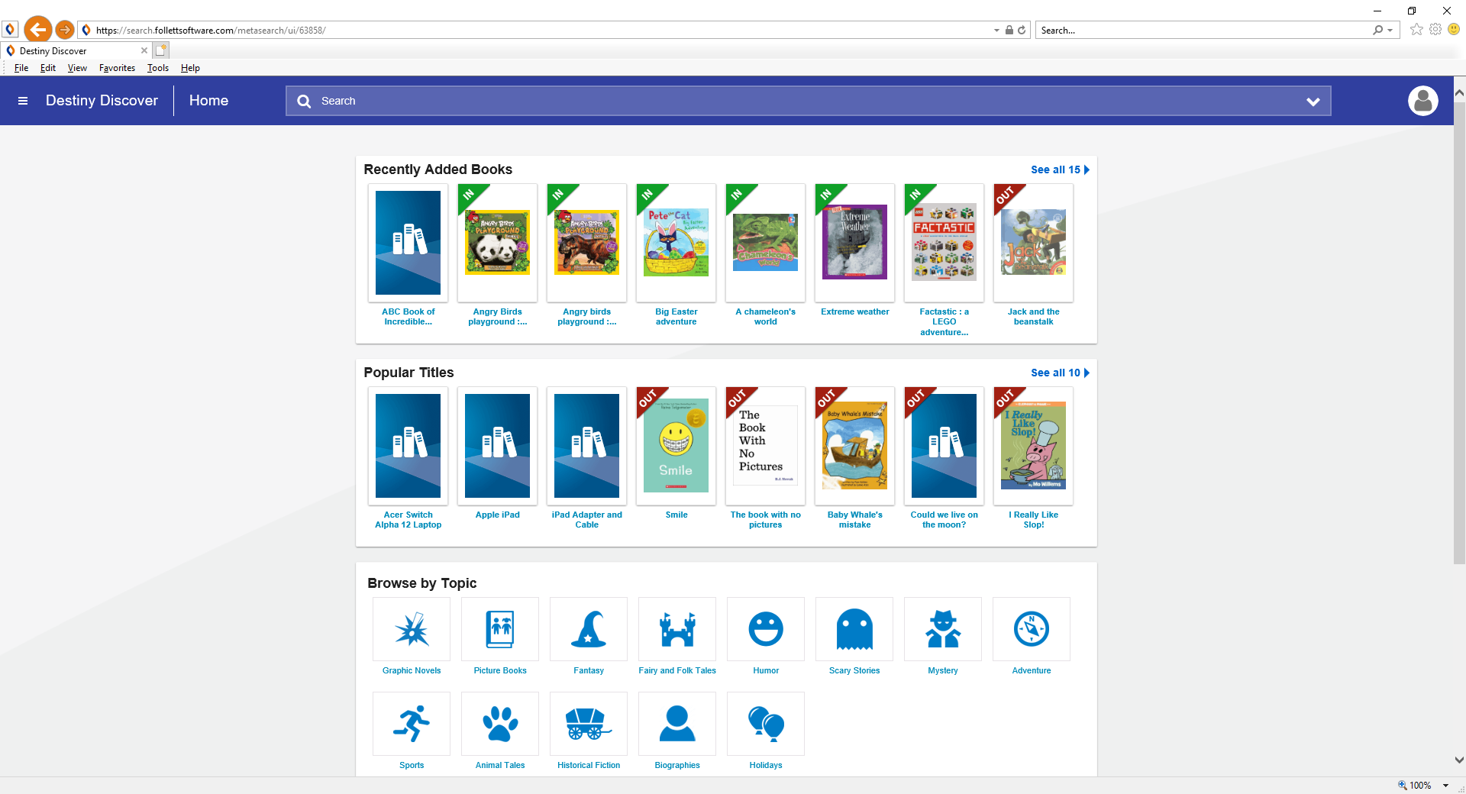
Destiny Discover Login
User Name = your first and last name (no space)
password = student.123
This will get you to your destiny Discover home screen

Slide 6
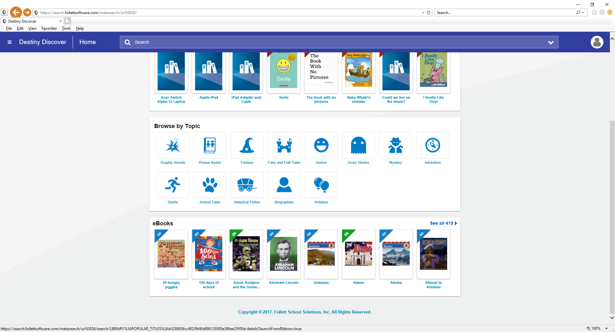
Under eBooks in the middle of the page, select “See All” on the right-hand side.

Slide 7
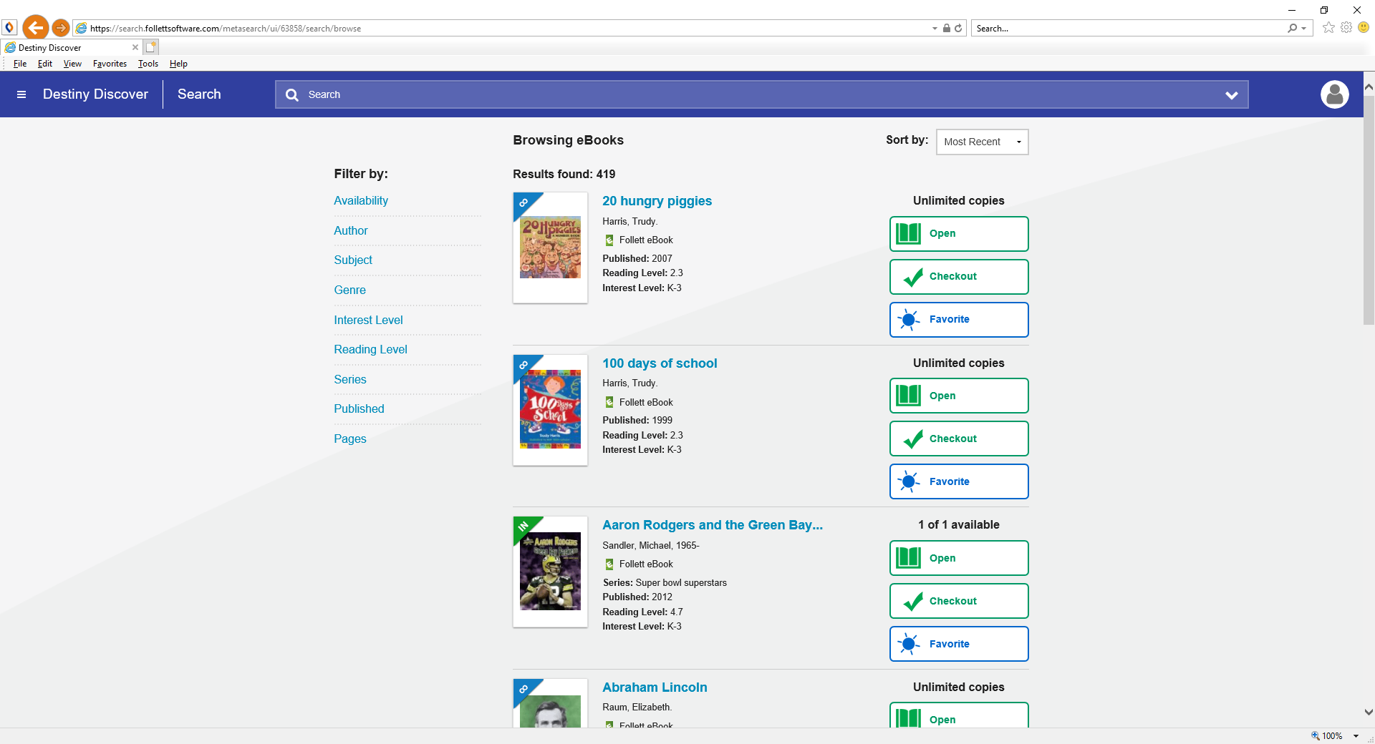
Destiny Discover eBook Screen
From here, you can open an eBook, you can check one out, or you can review and mark as your favorite.

Slide 8


We can filter by different categories
You can use the menu on the left to look for different kinds of books
Click on Genre, then click on all to see the categories of genre and how many of each there are.

Slide 9
Types of Check Outs
The green “IN” on the corner of the book means that only one person may look at or check out the book at a time.
The blue “infinity” symbol on the corner of the book means that as many people as want may look at or check out the book.

Slide 10

Let’s press “Open” on the book “Aaron Rodgers and the Green Bay Packers”.

Slide 11
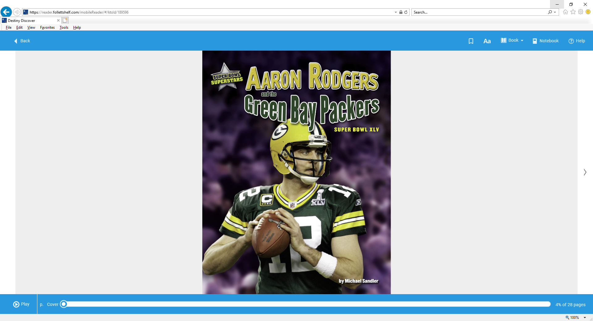
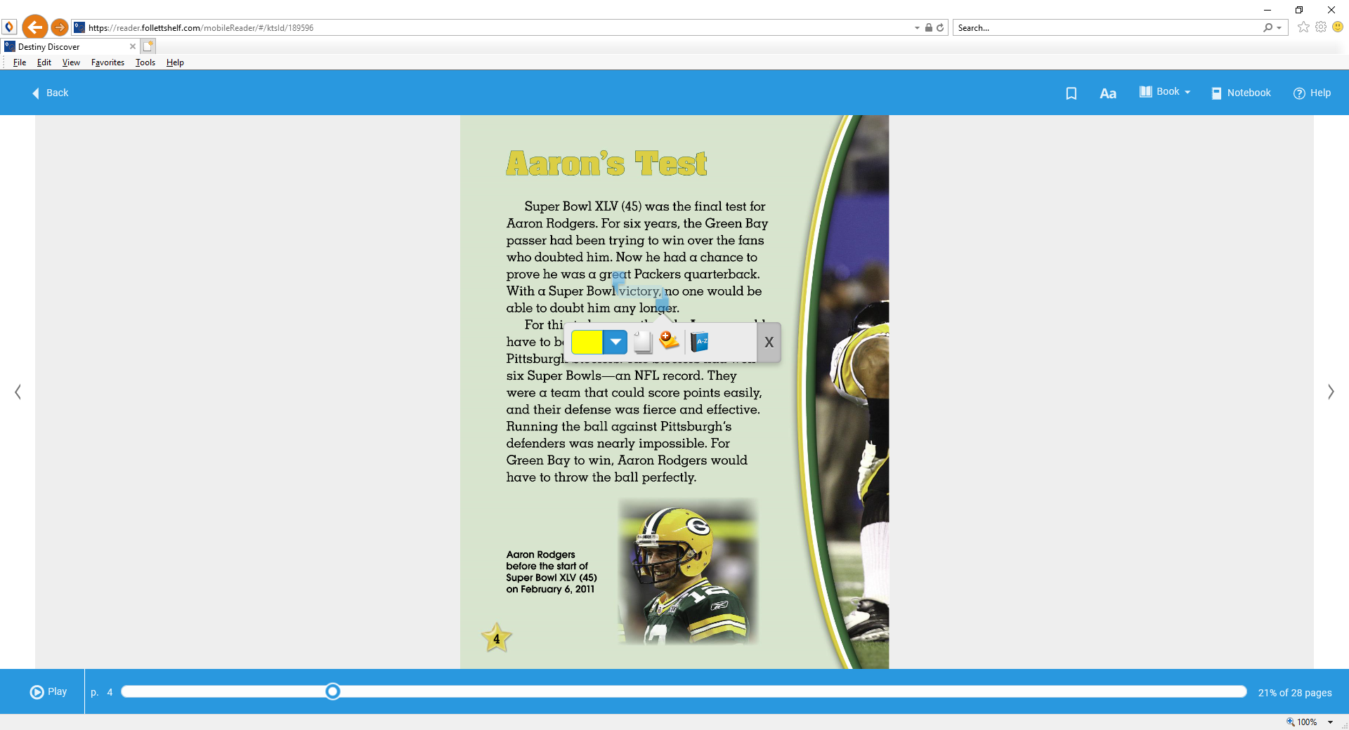
Example of an eBook
The book will open to the cover.
Turn the pages until you come to the first page of writing.
You can highlight passages by clicking and holding down until the highlight starts, then drag until the end of what you want to highlight.

Slide 12
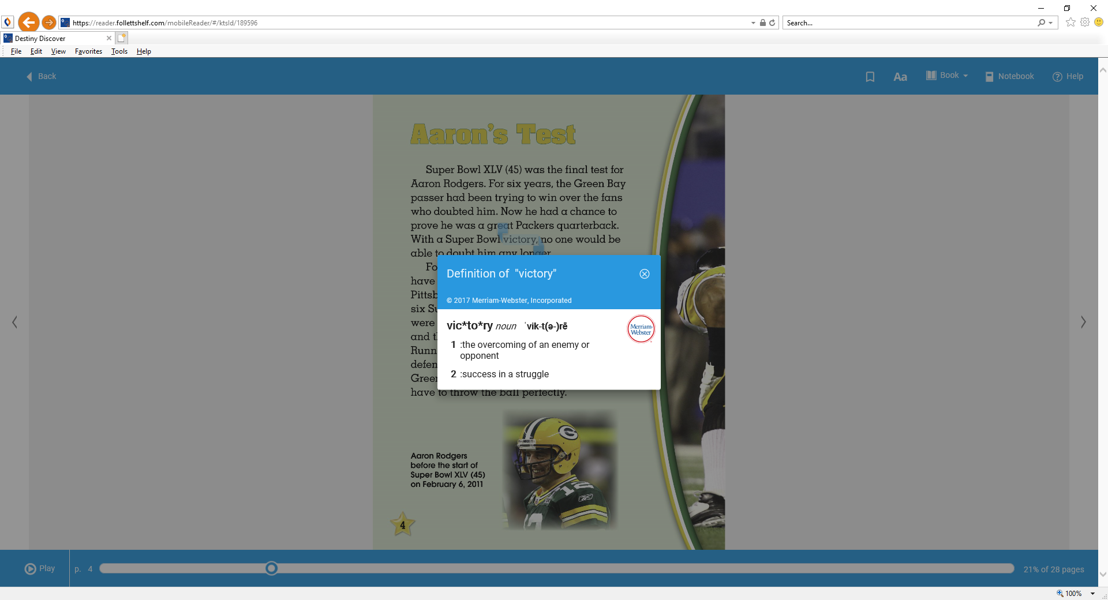
Highlight to look up word definitions in the dictionary
Click on THE word and hold down until it highlights.
Click on the “a-z” symbol for THE dictionary.
When you open the dictionary, it will normally give you definitions unless it is not in the follett dictionary.

Slide 13
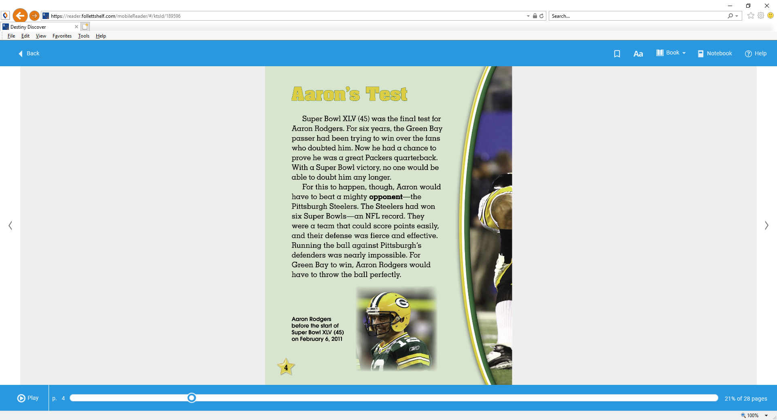
Let’s go ahead and close the book by pressing the “back” button in the upper left corner.

Slide 14
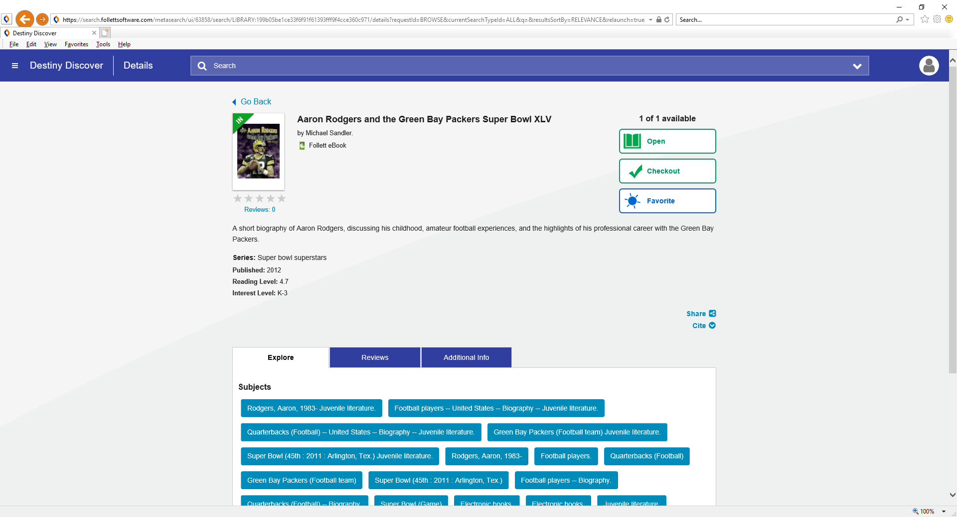
You can check out a book by clicking “Checkout”. eBooks can be checked out for 7 days.

Slide 15

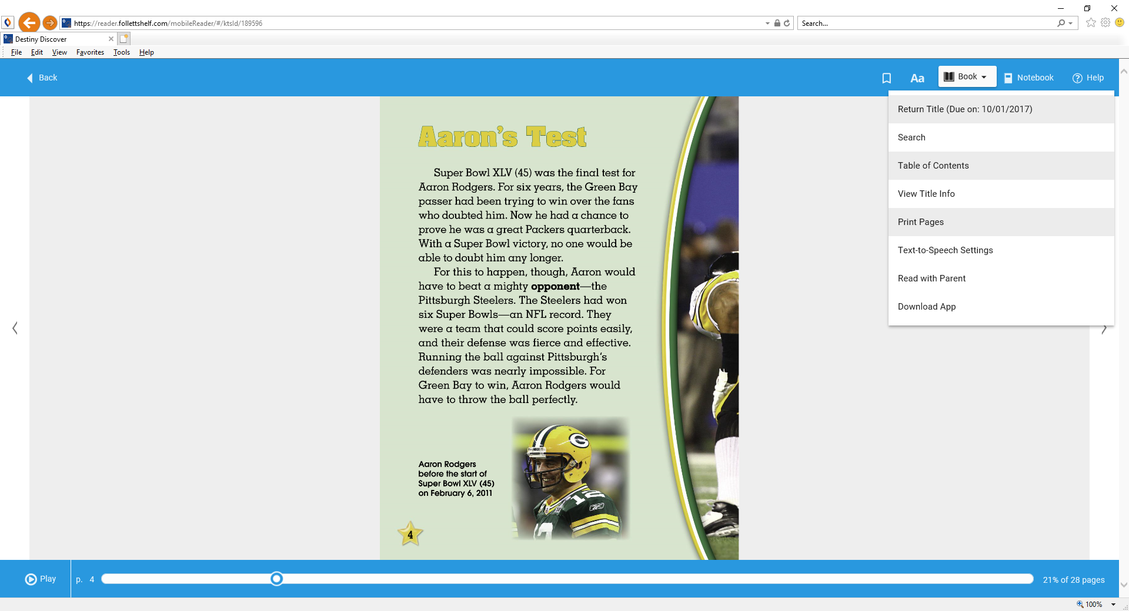
Returning a Checked Out eBook
You can return an eBook on this screen by selecting “Return”.
Or you can return an eBook while you are reading it by selecting “Book” on the top of the page and selecting “Return Title”.

Slide 16


Some Rules for Using eBooks at NGES
You may check out one eBook at a time.
eBooks may be checked out for 7 days only.
Download the “Destiny Discover” app onto your mobile device (smart phone, iPad, tablet, etc) to check out eBooks from NGES from your mobile device.

